Slide 1



Supporting Blind and Visually Impaired Students
Members’ Webinar
Sponsored by

Slide 2
Members’ Webinar
NADP offers:
Training
Accreditation
CPD opportunities
Journals and resources
Find out more at www.nadp-uk.org
Sponsored by

Slide 3
Housekeeping
British Sign Language Interpretation
  Click the three dots on the bottom right
  Select Interpretation, then BSL
Captions
  Navigate to meeting controls toolbar at the bottom of the screen
  Click the Show Captions icon (‘CC’ in a box)
Questions and Comments
  Use the Q and A section to type any questions or reflections for presenters
  Use the Zoom chat on the right for general comments, discussion, and introductions
Recording
  This session will be recorded and available to watch back in a few weeks

Slide 4
Today’s Agenda
1.00pm-1.05pm, Welcome and Overview, NADP
1.05pm-1.25pm, Accessible Resource Creation, Vibi Rothnie, Royal National Institute of Blind People (RNIB) Transcription Centre Leeds
1.25pm-1.45pm, Case study: Supporting students with visual impairment at the University of Southampton, Luke Searle, University of Southampton
1.45pm-1.50pm, Sponsor Message, Dolphin Computer Access
1.50pm-2.00pm, Break
2.00pm-2.20pm, Supporting the Social and Emotional Needs of Visually Impaired Students, Ifigeneia Manitsa, University of Birmingham
2.20pm-2.40pm, Practical Adjustments and Support Case Studies, Thomas Pocklington Trust
2.40pm-3.00pm, Q&A Session, Thomas Pocklington Trust

Slide 5
Supporting Blind and Visually Impaired Students in Higher Education
Creating Accessible Resources
Vibi Rothnie, RNIB (December 2025)

Slide 6
INTRODUCTION (RNIB)
Contract
Team

Slide 7
THE SERVICE
Structured Word / Large print
Type of material transcribed (VLE content; PowerPoints; journal articles; chapters from textbooks; complete books)
RNIB Bookshare
Service users

Slide 8
THE PROCESS
Referral
Student preferences
Source file to end product
Delivery
Archive
Challenges

Slide 9
SPECIFIC EXAMPLES
VI PhD student, C
VI+ PhD student, G
VI PhD student, A
VI UG student, U

Slide 10
FEEDBACK
VI UG
“I have found the transcription service amazing”
VI PhD
“It’s a wonderful resource, which I sincerely hope will continue throughout the rest of my time at Leeds and long beyond”
VI PGT
“One of the things I can always rely and makes my course journey so much easier is your transcriptions of documents”

Slide 11
UniACT(s)
UniACT(s) - University Accessible Content and Transcription(s)
Discussion list
Meetings – 2.30-4pm 17 December 2025

Slide 12
CONTACT DETAILS
Vibi Rothnie (she / her)
Leeds Transcription Contract Manager
Eye Care Support Services
RNIB (Royal National Institute of Blind People)
RNIB Transcription Centre Leeds
Disability Services
Chemistry West Block
University of Leeds
LEEDS LS2 9JT
t: 0113 733 9953
e: Vibi.Rothnie@rnib.org.uk
e: rnibleedsuniversity.mailbox@rnib.org.uk

Slide 13
University of Southampton

Slide 14
Case study: Supporting students with visual impairment at the University of Southampton
Luke Searle
09 December 2025

Slide 15
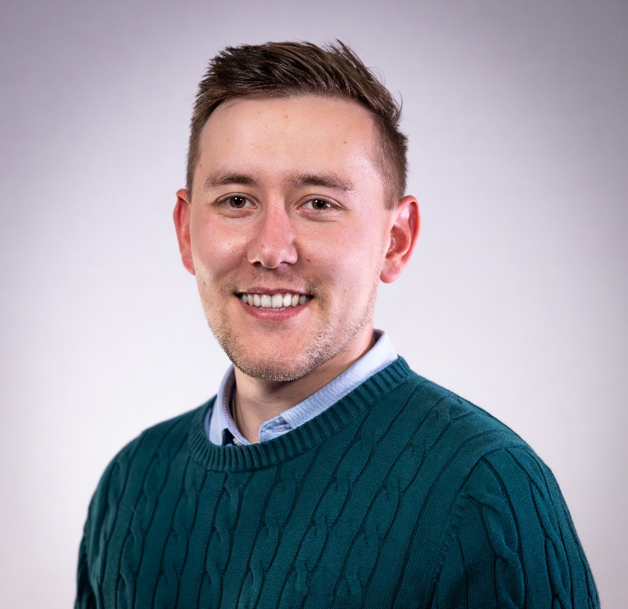
Introduction (Southampton)
Initiative Name: 1-2-1 Student Support
Partnership: Collaboration between the Digital Learning team and various student experience departments to support a Health Sciences student.
Objective: Improve the student experience of a student seeking support with a visual impairment.
Service implementation: Leveraging technologies such as Blackboard, Anthology Ally, ServiceLine and Assistive Technologies.
Luke Searle (he/him)
Senior Learning Designer (Team Lead)
Luke Kimber-Bradshaw on LinkedIn

Slide 16
Our specific support strategy
Supporting individual experiences with personalised support
Initiating support
Reviewing learning content accessibility with Anthology Ally
Building key partner awareness and confidence of assistive technologies
Developing of content remediation plans
Involving students through our Accessibility Ally internship programme
Reviewing impact with key partners.

Slide 17

Initiating support
Meeting with the student
  Identifying current support provisions
  Identifying support preferences
  Identifying support challenges
Meeting with Student Disability and Inclusion team
  Review current Specific Support Recommendations (SSR)
  Proposing communication flow and cadence
Meeting with programme team
  Identifying support with deploying SSRs
  Reviewing the accessibility of learning content with Ally

Slide 18
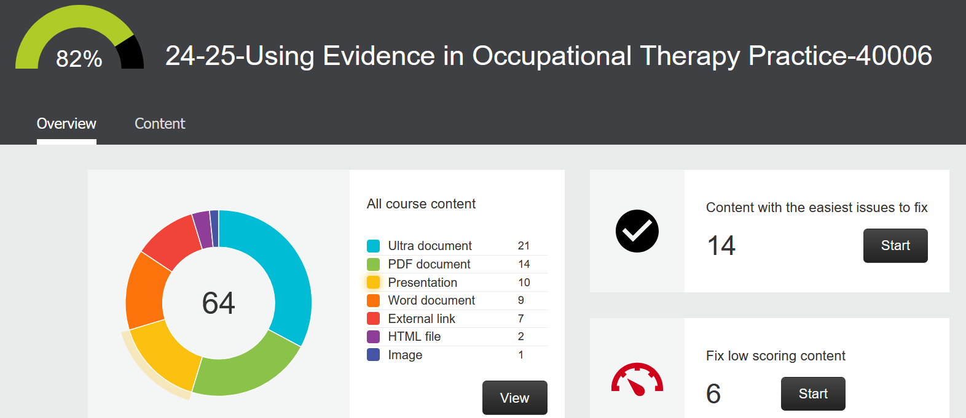
Reviewing learning content accessibility
Full module review to ensure alignment with institutional targets.
Identifying content with accessibility issue likely to impact visual experience
  Motion
  Colour contrast
  Image Descriptions
Timely release of content
Blackboard module structure setup for VI access
Lecture capture use

Slide 19

Building key partner awareness and confidence using assistive technologies
Library and student life
  Assistive Technology suite
  Library helpdesks
  SDI team
  Academic Skills
  Students Union
Creation and distribution of support recommendations
Communication flow between teams
  ServiceLine (CRM) ticket for all distinctions
  1-2-2s with the student

Slide 20

Specific resource remediation methods
PDF and Word files
  Tagging (PDF)
  Applying document headings
  Reformatting graphs and charts as data tables
  Sourcing eJournals
  Formatting mathematical expressions
Blackboard Ultra
  University of Southampton ‘Universal Standards’
  Staff Development Sessions

Slide 21

Feedback from student
Feedback following a meeting with SDI and student
We both agreed we would like to pass on that we are extremely appreciated of all the work completed. The team have worked quickly and efficiently, and the work is hugely significant in enabling [name] to access course content which [they] would otherwise have to spent a lot of time modifying before being able to access it.
“
”

Slide 22
Your Questions

Slide 23
A word from our sponsor
Dolphin Computer Access
Members’ Webinar
Sponsored by

Slide 24


How Dolphin Can Support Higher Education
SuperNova Education
  Provides screen reading, magnification, and braille support.
  Ensures full accessibility for digital learning platforms and resources.
  Empowers independence and equal participation in lectures and assessments.
EasyReader
  Gives access to textbooks and academic materials in accessible formats (DAISY, EPUB).
  Simplifies navigation and reading for study and leisure.
  Enhances inclusion and supports wellbeing by reducing barriers.
Together
  Improve academic success and confidence.
  Support social and emotional wellbeing.
  Enable universities to meet accessibility standards.
Notes:
Introduce my self and title
“we’ll explore how SuperNova serves as a vital tool for assessors working with individuals who have visual impairments. We’ll cover its features, benefits, and practical applications to help you make informed assessments”
-about dolphin

Slide 25
Break
1.50pm-2.00pm
Members’ Webinar
Sponsored by

Slide 26

Designing university guidance for the educational inclusion of students with vision impairment in Higher Education: A participatory research approach
Supporting Blind and Visually Impaired Students
Ifigeneia Manitsa, Research Fellow, School of Education, University of Birmingham
i.manitsa@vham.ac.uk

Slide 27
Introduction (Birmingham 1)
HESA (Higher Education Statistics Agency) reports in the academic year 2020/21 that there were 3,450 students enrolled in UK universities whom they categorised as “blind or with a serious visual impairment”. This number has risen steadily over the last decade.
There does not appear to be adequate guidelines in place to support this group in terms of social inclusion and social emotional needs (Croft, 2020).
University students have expressed their dissatisfaction with both the social support available to them and the lack of staff training in this area (Manitsa & Doikou, 2020).

Slide 28
Introduction (Birmingham 2)
Past research has highlighted several issues relevant to the current study:
Reporting of mental health difficulties in students with vision impairment
The relationship between social relationships and self-esteem
The importance of social and emotional support for well-being and independent living
The importance of institutional support for students with VI in universities
However, a review of literature highlighted a significant gap in research focussed on university settings.

Slide 29
Key Objectives
To explore the lived experiences of students with VI in Higher Education (HE).
To identify the lack of holistic and person-centred approaches to the socio-emotional needs of individuals with VI wishing to attend HE in the UK.
To acknowledge the socio-emotional needs of students with VI and the urgent need to provide socio-emotional support at all educational levels.
To initiate the development of university guidance that will address the socio-emotional needs of students with VI and can be implemented at university level based on participatory research and co-production.
To promote the social inclusion of people with VI in HE.

Slide 30
Research Phases: Phase 1 (a)
PARTICIPANTS AND PROCEDURE
Twenty-six online semi-structured interviews with
15 adults with VI enrolled in and pursuing a university degree (undergrad, masters, and doctoral students) and/or adults with VI who have recently (within the last five years) completed a university degree
11 professionals from VI services (e.g., the Thomas Pocklington Trust) and university staff (e.g., disability officers and academics) who work with students with VI
Aim: Discuss the social emotional experiences of students with VI in HE and their suggestions for future practice at university level

Slide 31
Research Phases: Phase 1 (b)
MATERIALS
Adults with VI
Demographic questionnaire with items focusing on specific demographics (e.g., ethnicity, DOB and current situation in HE) and on their vision and current physical and mental health (e.g., registration status and presence of additional needs)
Semi-structured interviews with questions focusing on
Current experience within the university
Social experiences related to university experience
Provision of socioemotional support
Recommendations for future practice and policy

Slide 32
Research Phases: Phase 1 (c)
MATERIALS
Professional staff
Demographic questionnaire with items focusing on specific demographics (e.g., ethnicity, DOB and current situation in HE) and on current professional role and experience with people with VI
Semi-structured interviews with questions focusing on
Involvement and experience with university students with VI
University experiences and the provision of socio-emotional support to students with VI
Recommendations for future practice and policy

Slide 33
PARTICIPANTS AND PROCEDURE
Research Phases: Phase 2
Development of two advisory groups with
five university students with VI
seven staff members from professional organisations in the field of sight loss such as the Thomas Pocklington Trust and university staff
Two 90-minute online sessions were held with each advisory group to discuss the findings of the first phase as well as suggestions for future practice.
Aim: Define the key pillars of the proposed university guidance

Slide 34
TOPIC AREAS
Research Phases: Phase 2
Specific examples of good practices and support in the university
Current challenges
Access to social clubs (e.g., sport clubs) and impact on university experience
Relationship with other students outside university
The role of other students, academic and administrative staff, and Government in the inclusion of students with VI in Higher Education
The strengths and weaknesses of the Mental Health and Wellbeing: A Guide for Blind and Partially Sighted Students - Thomas Pocklington Trust

Slide 35
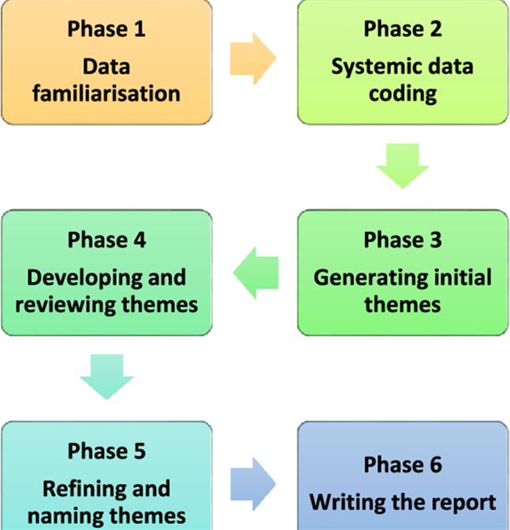
Data Analysis
Reflexive Thematic Analysis emphasises a flexible process of coding data and identifying themes building upon Braun & Clarke’s (2021) original six steps of thematic analysis:
familiarisation with the data by repeatedly reading the transcripts
initial coding of key features of the data
searching for and generating possible themes and sub themes
checking the identified themes against the data
naming and defining the identified themes
writing up the results.

Slide 36
Main Findings 1)
The findings highlighted the interconnectivity between vision impairment and mental health, the importance of proactive action and preparation from university staff and the diverse academic and social and emotional needs of students with vision impairment.
  “I would say I was really touched when one of the academic staff, she was proactive when offering support. So instead of saying, ‘If you need anything, just talk to me,’ instead she just said, ‘What do you actually need? How about if I do that? And if I do that, is it really clear for you? Or do you want me to do it in another way?’ So, she was very proactive when offering the support.” (Currently pursuing a degree, male, 24 years)

Slide 37
Main Findings 2
Participants emphasised the power of shared experiences in implementing social support, the urgent need to promote departmental collaboration, the importance of fostering student confidence and the significance of specialised staff training.
  “… So, the key thing is consistency. Because it has been said that ‘Oh, different departments deal with things differently,’ but it shouldn’t be, because obviously the visual impairment stays the same, the reasonable adjustments will stay the same, there shouldn’t be any difference between the way it’s looked at, from one department to another.” (Completed a university degree in the past five years, male, 52 years)

Slide 38
University Guidance 1
Based on the findings of both Phases, we have developed recommendations related to the social and emotional support for students with vision impairment, for three key stakeholders:
University staff
Policy Makers
Vision Impairment Sector
These recommendations have been further divided into the following categories according to the time and financial resources required to implement them:
Short-Term
Medium-Term
Long-Term

Slide 39
University Guidance 2
RECOMMENDATIONS FOR UNIVERSITY STAFF
Short-term recommendations
Implementing a Standardised Baseline of Accessibility in Academic Courses
Interventions to support the social and emotional inclusion of students with VI
Adopt an active approach to implementing social support: formal education activities, the wider social experience
Provide targeted support for transitional periods
Promote the development of student autonomy in seeking social and emotional support

Slide 40
University Guidance 3
RECOMMENDATIONS FOR UNIVERSITY STAFF
Medium-term recommendations
Improve the Visibility, Signposting and Awareness of Mental Well-being Services to Students Through Active Engagement

Slide 41
University Guidance 4
RECOMMENDATIONS FOR UNIVERSITY STAFF
Long-term recommendations
Provide staff training in disability awareness and inclusive practices
Adopt policies that emphasise a personalised and person-centred approach
Define professional frameworks within institutions to clarify the boundaries, roles and responsibilities of staff
Adopt a collaborative, inter-departmental approach to supporting the social and emotional experiences of students with vision impairment

Slide 42
University Guidance 5
RECOMMENDATIONS FOR FUTURE POLICY MAKING
Develop measures to assess the social inclusion of students with vi in higher education institutions

Slide 43
University Guidance 6
RECOMMENDATIONS FOR THE VISION IMPAIRMENT SECTOR
Work with the HE sector to review the current availability of training courses to ascertain whether there is a need to develop new training offers.
Develop resources to support the implementation of the recommendations above within higher education institutions.
Support HE institutions in implementing the recommendations through the Thomas Pocklington Trust Student Support Service.

Slide 44
University Guidance 7
RECOMMENDATIONS FOR THE VISION IMPAIRMENT SECTOR
Work with the HE sector to review the current availability of training courses to ascertain whether there is a need to develop new training offers.
Develop resources to support the implementation of the recommendations above within higher education institutions.
Support HE institutions in implementing the recommendations through the Thomas Pocklington Trust Student Support Service.

Slide 45
Conclusion
The findings underscore an urgent need for Higher Education institutions to prioritise accessibility for students with VI at an institutional level.
This prioritisation should encompass
the establishment of a baseline level of accessibility,
the implementation of VI-specific staff training,
the facilitation of close collaboration between departments,
the implementation of peer-support networks, mentoring schemes and VI societies.
Students will be able to develop confidence and skills that will enable them to thrive during life after university.

Slide 46
Suggested References
Braun, V., & Clarke, V. (2021). Thematic Analysis: A Practical Guide. Sage.
Croft, E. (2020). Experiences of visually impaired and blind students in UK higher education: An exploration of access and participation. Scandinavian Journal of Disability Research, 22(1), 382–392. http://doi.org/10.16993/sjdr.721.
Hewett, R., Douglas, G., McLinden, M., & Keil, S. (2017). Developing an inclusive learning environment for students with visual impairment in higher education: progressive mutual accommodation and learner experiences in the United Kingdom. European Journal of Special Needs Education, 32(1), 89–109 https://doi.org/10.1080/08856257.2016.1254971 .
Manitsa, I. & Doikou, M. (2022). Social support for students with visual impairments in educational institutions: An integrative literature review. The British Journal of Visual Impairment, 40(1), 29–47. https://doi.org/10.1177/0264619620941885.
Manitsa, I., Temple, S., Hewett, R., Barlow-Brown, F., Ravenscroft, J., Joao, R.*, Thurston, M.* (2025). Supporting the social and emotional needs of students with vision impairment: guidance for high education providers. Journal of Inclusive Practice in Further and Higher Education (JIPFHE), NADP Journal. https://nadp-uk.org/https-nadp-uk-org-jipfhe-17-1-summer-2025/ *authors contributed equally

Slide 47
Thank you!
Any questions?

Slide 48
48
Notes:
Introductions to speakers and to Thomas Pocklington Trust.

Slide 49
Practical solutions to support blind and partially sighted students
Solutions will always be dependent on the student’s level of functional vision and how they access their learning. There is no one size fits all solution!

Slide 50
Practical solutions
Things to consider:
Student's background and normal ways of working
DSA funded vs university funded support
Module outcomes and competency standards vs reasonable adjustments

Slide 51
Practical solutions - STEM
There is a large jump from Further Education to Higher Education on level of complexity of subject matter e.g. calculus, geometry, 3D representations
Presenting complex visual data – variety of solutions:
Braille devices with tactile displays (Monarch or Q40 Mantis)
Magnification software
Non-medical help to support (Practical Support Assistant)
Tactile markers, labels etc. where appropriate
Accessible software on course (and be aware of software that isn't accessible!)
Transcription services vs in house support

Slide 52
Practical solutions - Placements
Requirements to work in clinical or laboratory-based environment can sometimes cause barriers for blind and partially sighted students:
Navigating physical space and environment of placement – planning ahead is key
Health and safety and risk assessments
Accessing clinical data on placement equipment, handwritten notes etc. - understanding the placement's GDPR requirements
Competency standards of the course + placement vs reasonable adjustments

Slide 53
Case Study 1
Student was required to analyse printed lab results in “real time” following an experiment. They had no functional vision and used a combination of screen reader, touch typing and braille display.
Options explored:
Competency standard – is reading "real time" printed results a requirement? What is being assessed?
Practical support assistant/note taker/lab technician who can provide graph translations in real time e.g. verbally.
Assistive Technology – lab results linked to braille device in real time using translation software

Slide 54
Case Study 2
Student was due on a teaching placement, but school were reluctant to support due to perceiving them as "high risk" from a health and safety perspective. Student had partial sight and was a cane user
Options explored:
Explore school's understanding of "high risk" vs what needs to be achieved in the classroom
Joint risk assessment between university and school of environment
Training to school staff on VI awareness if needed
Pre-visits for student to be aware of classroom environment/layout and obstacles

Slide 55
Maymunah's experience

Slide 56
In conclusion...
There is not a one size fits all solution but there are usually simple ways to make a course accessible
Knowing the competency standards required of the course/placement will help inform the reasonable adjustments needed to be put in place
Knowing DSA's responsibilities vs the university's will ensure full support is given
Planning in advance, where possible, is key
Seek advice… we are here to help!

Slide 57
Information, Advice, and Guidance
Contact us:
Email: educationadvice@pocklington.org.uk
Phone: 0203 757 8040 (10am-5pm)
Webform: Education Information Advice and Guidance Service - Thomas Pocklington Trust

Slide 58
Q&A
Members’ Webinar
Sponsored by

Slide 59
NADP Online Winter Conference
Tuesday 20th January 2026, 11am-4pm
Next Event:
NADP offers:
Training
Accreditation
CPD opportunities
Journals and resources
Find out more at www.nadp-uk.org

