Slide 1


Disabled Student Commitment Publishing Action Plan

Slide 2
Agenda
11.00 - Introduction and housekeeping
11:05 - DSC national update
11.15 - Journey towards publication
11:50 - Break
12.00 - DSC journey panel
13.00 - Lunch
14.00 - Close

Slide 3

Housekeeping
Recording and transcription available on Teams
Quiet space in basement of The Hub
Lunch and refreshments will be served in Grab & Go
If you would prefer not to be photographed, please let us know
No fire alarms expected
Online:
Please keep yourself on mute
Use the pin feature to see the room
Use the chat function for Q&A
Use the chat for technical issues

Slide 4
The inclusive event
Access and inclusion built into event design
Community of practice with constructive and supportive conversations
Respect views, opinions, and experiences
Allow the right to self-identification and respect the diversity of identity
Be sensitive to issues of confidentiality

Slide 5
National update

Slide 6


Disabled Student Commitment: Publishing an Action Plan
National Update & LSBU significance

Slide 7
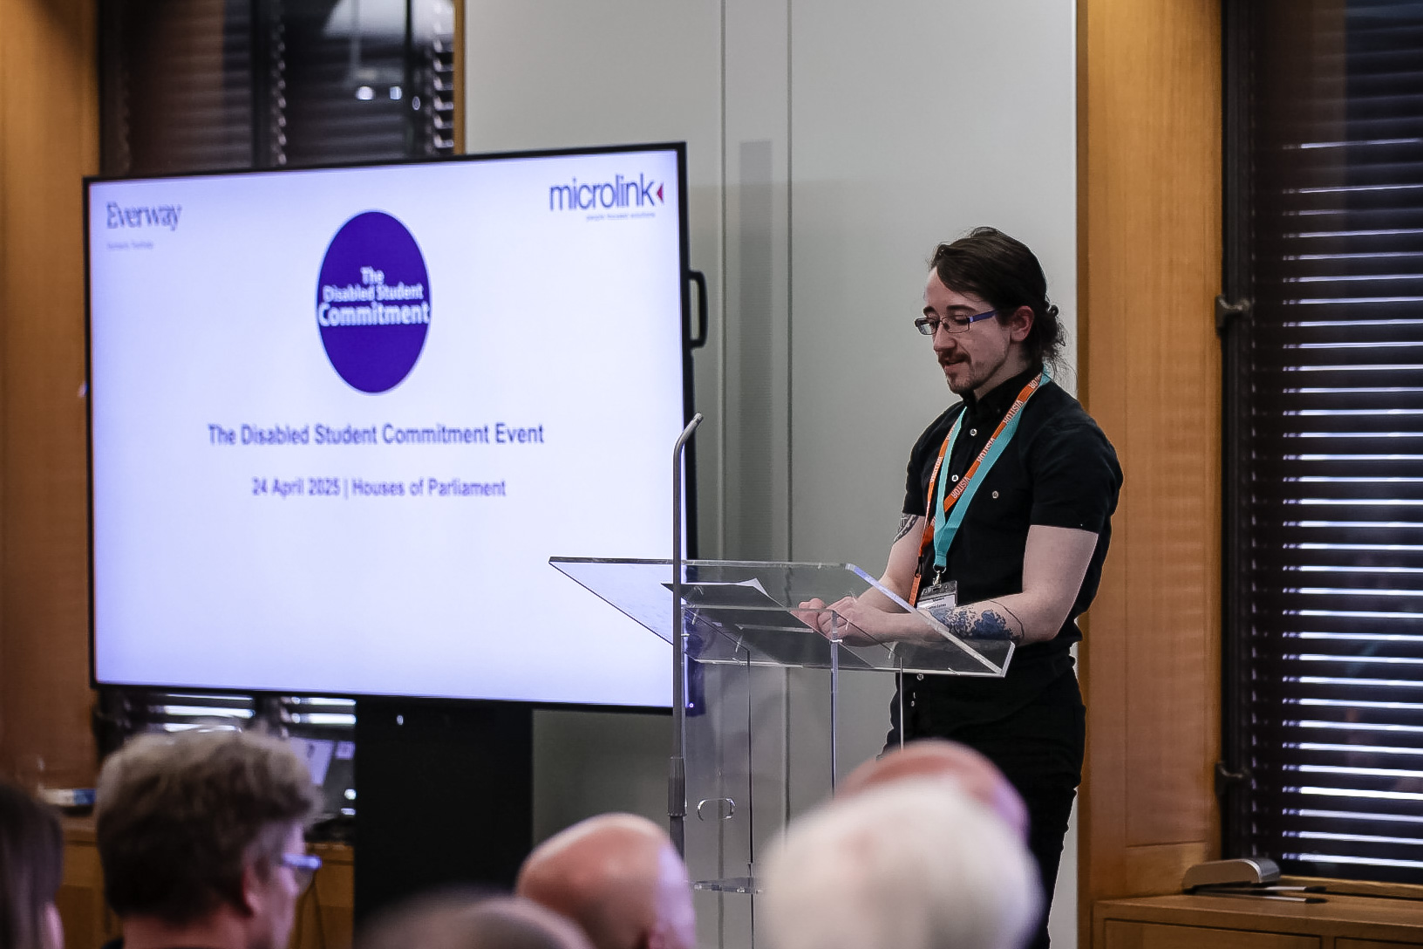
Disabled Student Commitment
25 Higher Education Providers
Annual institutional reporting
Special Interest Groups & Communities of practice
Sector Advocacy
Action Plan Publication

Slide 8
Significance to LSBU
Recognising and amplifying the untapped potential within our students
Understanding that each student is different and looking for ways to personalize support
Taking a whole-institution approach, from the point of enquiry all the way to graduation and next steps
Working in partnership with our disabled students
Being transparent about our plans and holding ourselves accountable

Slide 9
University of Greenwich
Message from Vice-Chancellor
Professor Jane Harrington

Slide 10
London South Bank University

Slide 11

Publishing an action plan
Jonathan Thompson – Disability and Dyslexia Support Manager
Phoebe Cleary – Disability Advisor

Slide 12
Background
Signed up in August 2023
Over 23/24 AY:
Self-assessment with internal stakeholders
Inclusive Practice Working Group
Disabled Student Panel
Disability Team self-reflection

Slide 13
Student Panel (1)
Put invite out to all disabled students
Selected members to ensure a range of disability, course type, international, apprentice etc.
Paid Panel members
Thematic meetings using the DSC (5 in total)
Terms of Reference
Relevant senior staff attended each meeting

Slide 14
Student Panel (2)
Hybrid meetings, ran every few weeks
Created questions for the Panel based around the touchpoint
Minutes/actions noted and circulated
After each Panel, met to consolidate and review actions

Slide 15
LSBU’s action plan
Summer 24 collated all Panel actions and created an in-depth action plan
Added Inclusive Practice Working Group actions (focused on ‘on course experience’)
Mapped actions, and ensured alignment with, our department/university strategy, EHRC and, E6
Reviewed with internal stakeholders to identify cross-over and actions to be tweaked
Circulated for approval to the Disabled Student Panel
Approved by Student Experience Committee

Slide 16
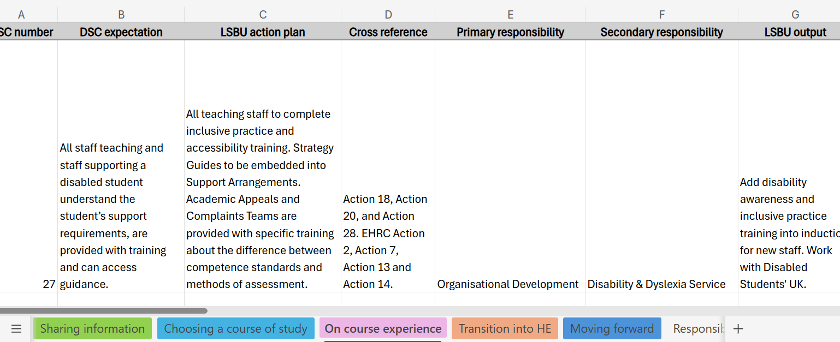
Snapshot of our in-depth plan

Slide 17
Publishing
Pulled out the key actions
Mirrored LSBU’s Wellbeing Strategy
Worked together with Greenwich to understand approach to publication
Shared through our Policies and Disability Team webpages
Pushed through social channels

Slide 18
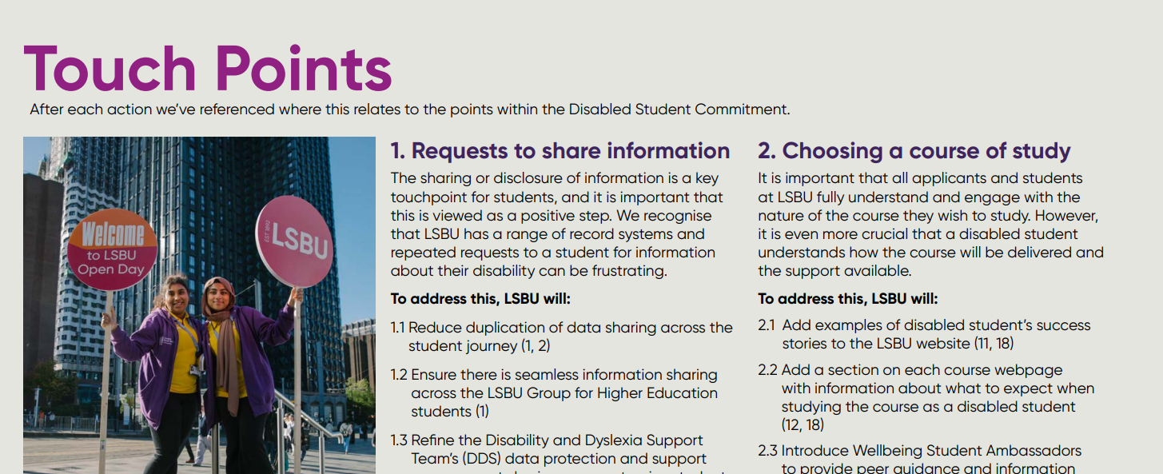
Published action plan
LSBU: Student Support

Slide 19
What difference has the DSC made?
With a focus on ‘On Course Experience’ the DSC has:
Provided a structure for the Inclusive Practice Working Group
Identified work already undertaken by curriculum facing colleagues
Informed our Disabled Student & Inclusive Practice Policy
Informed joint events on Assessment & Competency Standards
Created opportunities for DDS to review Rubric Marking Grids
Given permission to be loud and proud and take steps towards a whole institutional response

Slide 20
What’s next?
Created a Mental Health and Disability Strategy Working Group
Ongoing Inclusive Practice Working Group - with senior management
Review action plan within Disability Team each month
Starting to consider actions related to the other touchpoints
Actions built into Disability Advisors & SpLD Tutor’s PDRs for 25/26
Creating compulsory training modules informed by DSC & DSUK
London Higher Working Group
Review, review, review!

Slide 21
Special Interest Group
Group based around each touchpoint
Information sharing:
Creating a best practice guide
12 institutions contributed
Surveyed the sector through NADP, 22 responses
Case studies around each precept
Approval by Group in August
To be shared with wider sector

Slide 22
Contact details
Howsonl2@lsbu.ac.uk
Jonathanthompson@lsbu.ac.uk
Phoebe.cleary@lsbu.ac.uk

Slide 23
University of Greenwhich

Slide 24
DSC The Commitment: Publishing Action Plan
Shapna Compton
#EducationWithoutBoundaries
wellbeing@gre.ac.uk

Slide 25
Sector Leading

Slide 26
University of Greenwich
Journey
May 2023
DSC Working group re-engagement
VC Champion
Mapping Process
The Delivery Plan
Disabled Students Network
Student Union
Publication
DSC Working Group: Implementation

Slide 27
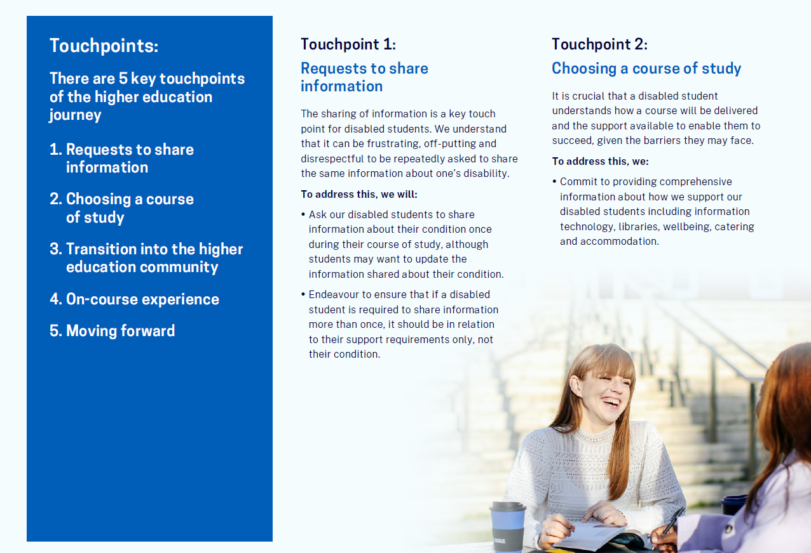
Action Plan
Overall:
5 touchpoints, 43 objectives
We have:
9 objectives
Notes:
Look and feel – your branding – LSBU and UOG just happen to have similar formatting

Slide 28
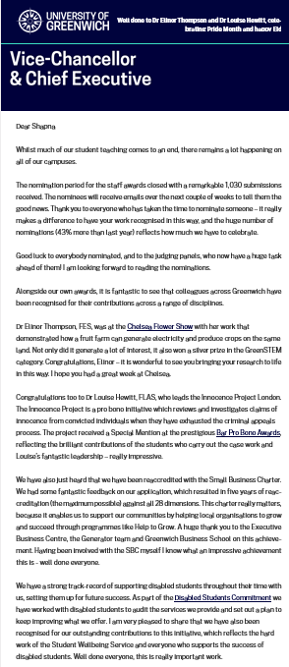
Communication
Webpage
  VC Newsletter
  Internal Comms
  External Events
  VC Special Recognition

Slide 29

Next steps
Implementation
Curriculum Shape
EC refinement
Working With SLM
STAART and Careers Team
Monitoring – working group and DSN
Impact

Slide 30

Sign up

Slide 31
Break

Slide 32
University of Brighton

Slide 33
Starting our Disabled Student Commitment Journey
Annie Beckett
University of Brighton
A..Beckett@brighton.ac.uk

Slide 34

University of Brighton context
c17,000 students
3 campuses
University Alliance institution
33-35% students tell us about a disability
New VC, Prof. Donna Whitehead
Facing traditional sector challenges and about to launch new institutional strategy:
  “different with less”
  Genuine focus on inclusion and access

Slide 35

Where we are
Signed up in May 2025 following UEB approval in March
Looking at synergies with the University Mental Health Charter
Currently scoping key priorities:
  Student Voice forum
  Implementation of prompt support
  Institutional drive for Inclusive Practice as a way of managing service volume
Lots of good practice but needs to be captured
Project aim to have Action Plan for early 2026

Slide 36
Southampton Solent University

Slide 37
Southampton Solent University
Tina Oze & Becky Harris
Disability Advice Team Leaders

Slide 38

Overview
Solent’s journey to date
Work to date
Planned development
Questions

Slide 39
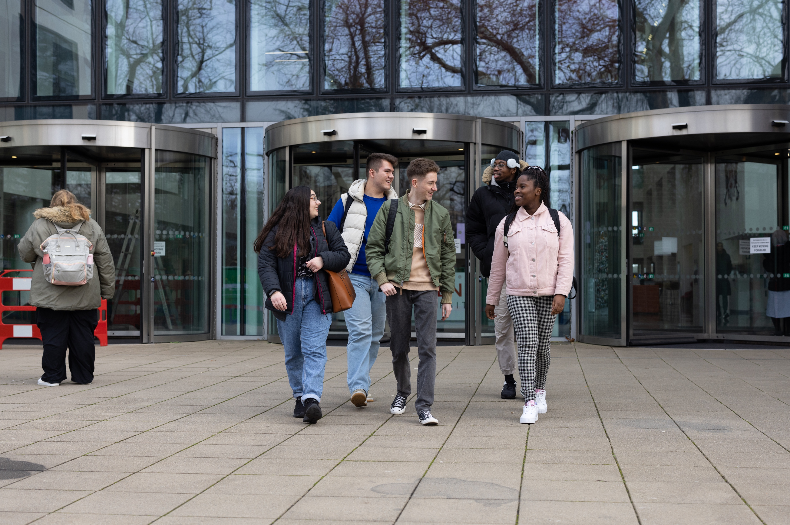
Solent’s journey to date
  Signed up in September 2024
  Task & Finish group chaired by Tania Struetzel (Director Student Success)
  Mapping exercise
  Action plan reviewed bi-monthly

Slide 40
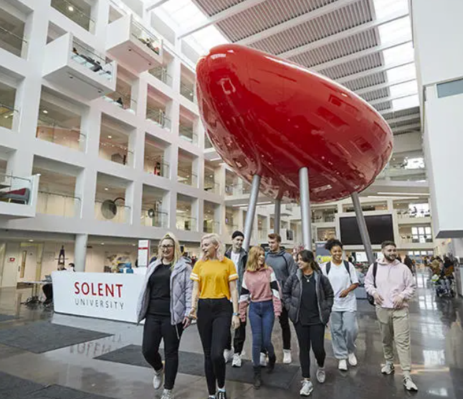
Work to date – our team
  Flexible evidence requirements
  Constructive Evidence Form
  Meetings on behalf of students
  Process for supporting attendance
  Support Plan review & storage
  Updated Disability Advice Team Consent Form
  Guide Dogs UK Sighted Guide training

Slide 41

Work to date – other Solent teams
  Review of university policies against OIA principles.
Agreed panel review process for Estates requests.
Student Union accessible campus survey.

Slide 42
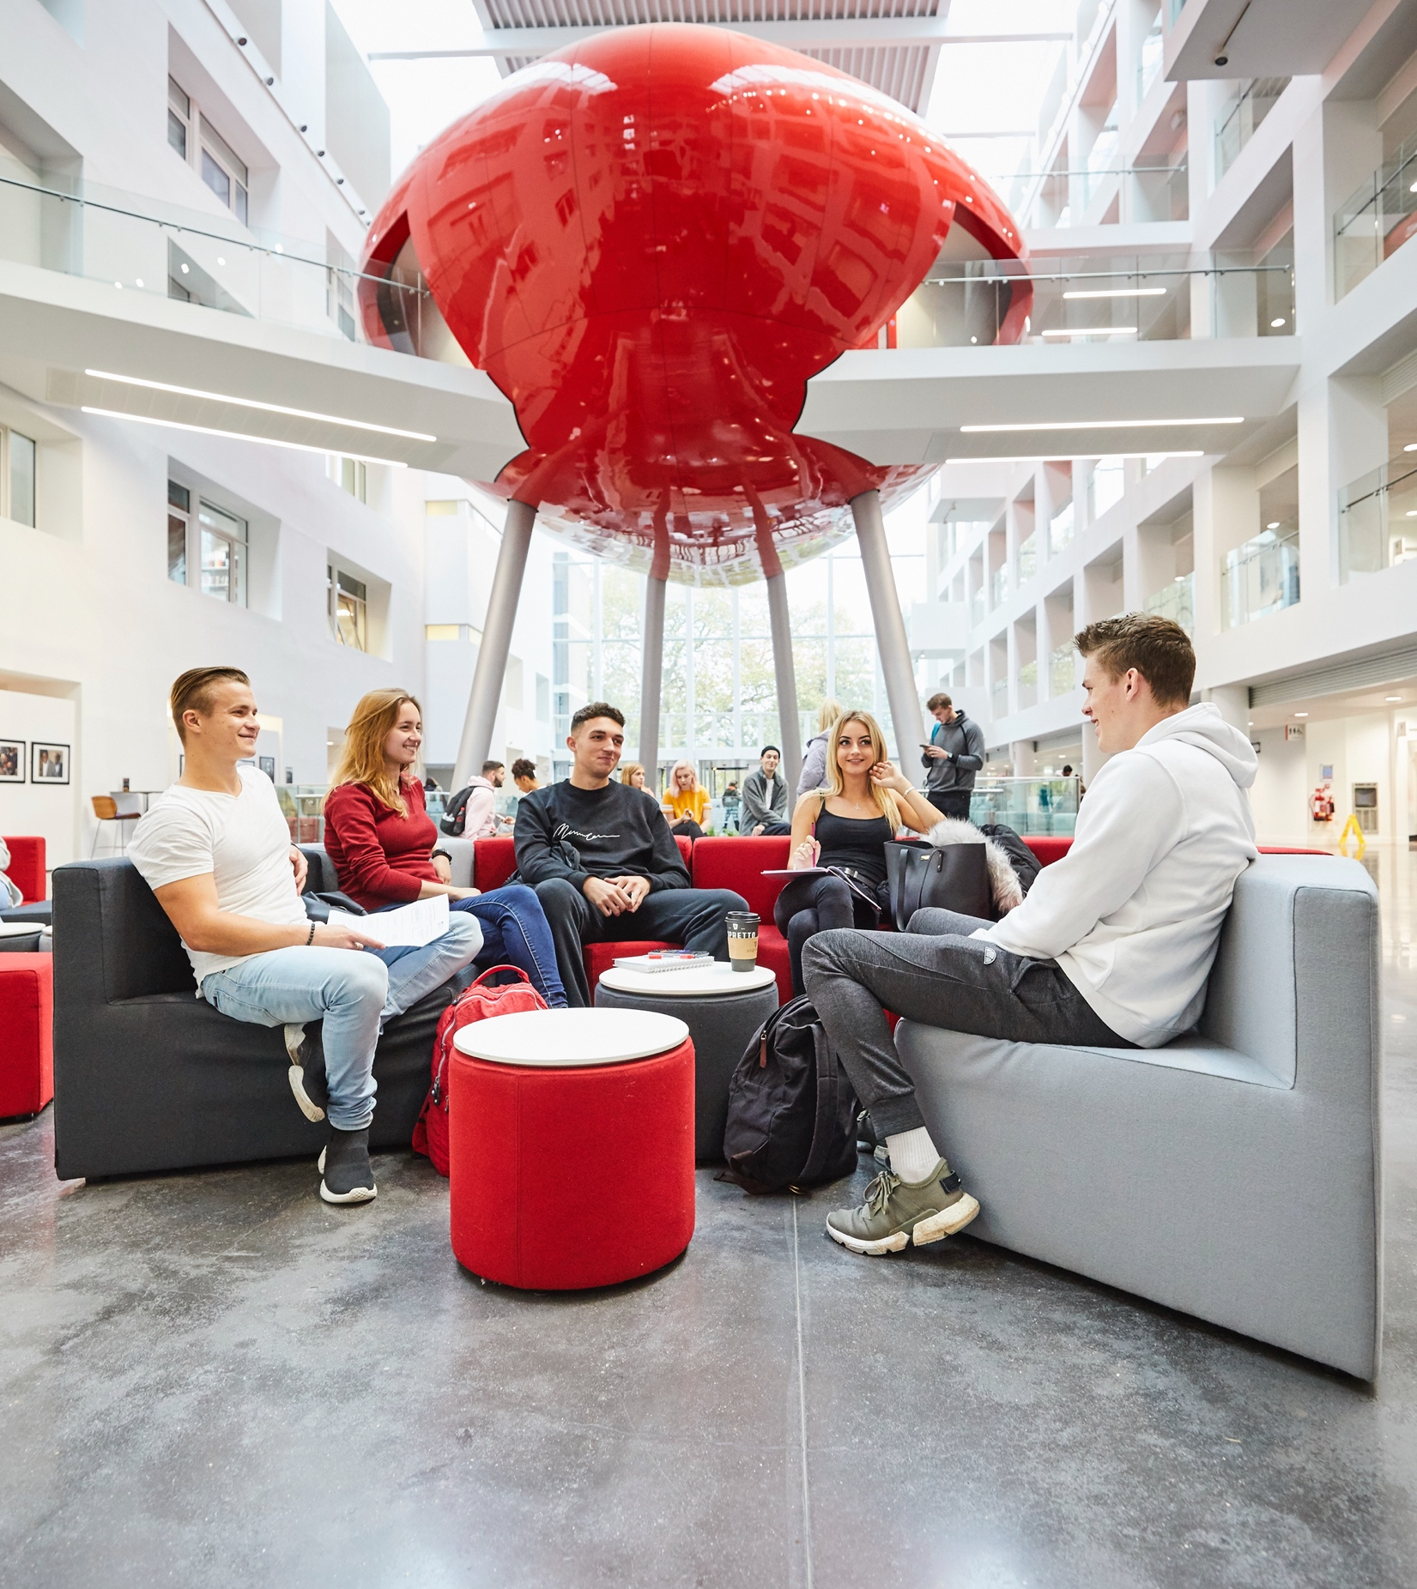
Planned development
  Staff training and resources
  Inclusive practice expectations
  7 day extensions
  Inclusive curriculum review
  Mode of assessment options
  Student Adjustment Planner resources

Slide 43
The Open University

Slide 44
Disabled Student Commitment Journey
Ciaragh Hubert – Director of Accessibility
July 2025

Slide 45
Who are we?
The Open University:
  We are an online distance learning university
  We have an open admissions policy
  Our students are not just based in the UK
  Our courses are available throughout Europe and some worldwide
  Over 38,000 disabled students are studying with us
Notes:
.

Slide 46
Our DSC journey so far…
Accessibility consultation completed
Accessibility priorities agreed and activity underway
Signed up to the Disabled Student Commitment
Mapped our existing plans and services against the Disabled Student Commitment
Student journey mapping carried out to identify key pain points
Notes:
.

Slide 47
Our next steps…
1. Agree prioritisation of specific DSC activity
3. Publish our DSC Action Plan
2. Embed DSC activity into workstreams
Notes:
.

Slide 48
Questions for the panel

Slide 49
Lunch

Slide 50
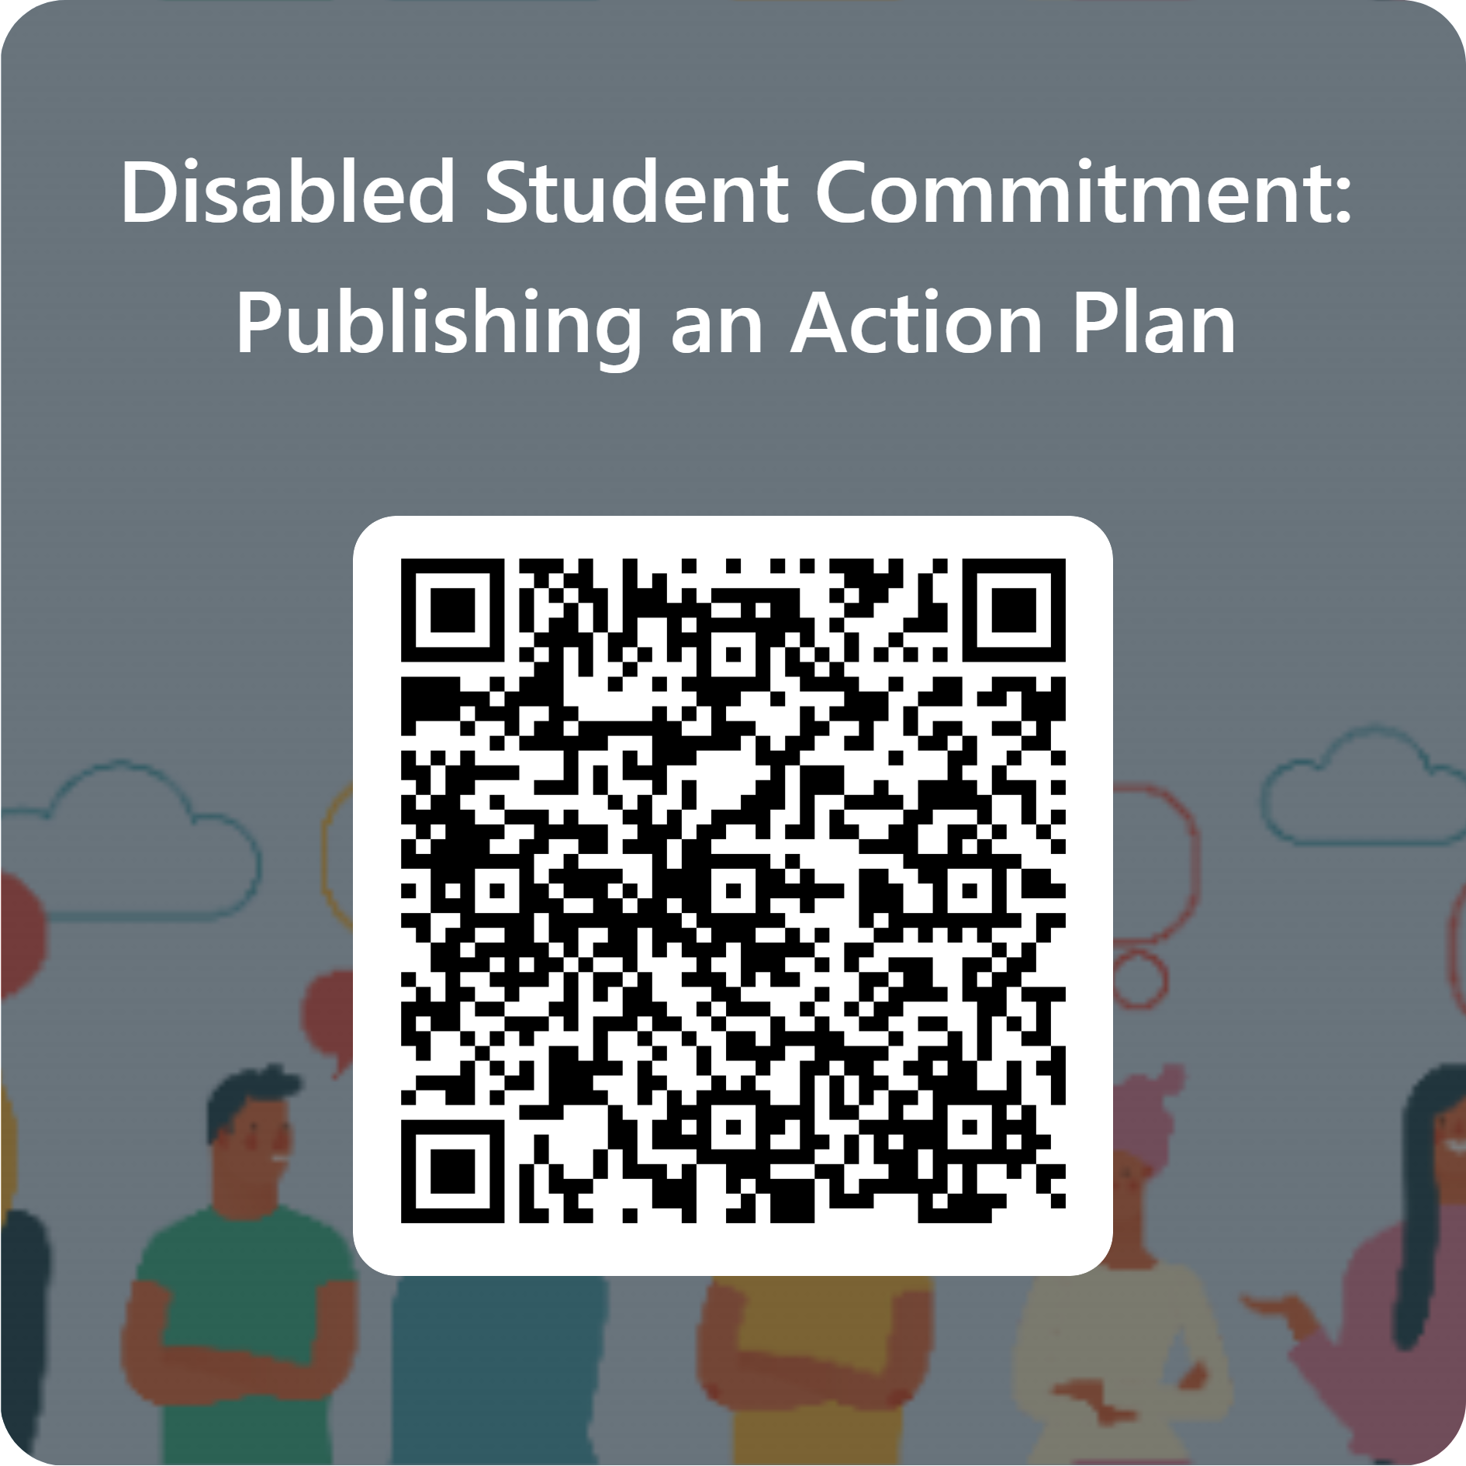
Shaping our community of practice

