Slide 1

The OIA's view: complaints from disabled students
Jo Nuckley, Head of Outreach & Insight
21 January 2025
Notes:
Thank you for inviting me to speak with you today. For anyone who is not familiar with the OIA, we are the student complaints ombuds scheme covering all HE provision in England and Wales. Our role is to review and resolve complaints from individual students, and also to share learning from the complaints we see.

Slide 2
Context – who complains?
2024 our busiest year ever, complaints received up approx. 15% of 2023.
Around a third of students complaining to the OIA in 2023 were identified as disabled. In 2024 this rose to just over 40%
  Of these, around 40% of students selected multiple categories when describing their disability
  Mental health challenges remains the largest category, followed by SpLDs
The majority of disabled students complaining to the OIA are home students
  Significant difference from our overall student complainant profile around domicile
Some indication that a slightly higher proportion of disabled student complainants may be studying at undergraduate level than the proportion for non-disabled complainants
Notes:
So to set, the context, we received around 3600 complaints from students in 2024. We ask students to tell us when they make their complaint if they consider themselves to be disabled as defined in the Equality Act 2010,. This is on a voluntary basis so there may be some under reporting. But there could also be some over-reporting, in that some students may tick the boxes even if their condition does not meet the strict legal definition especially around how long they have been experiencing an impairment or how long it is likely to last going forward. That still tells us that for those students, what they are experiencing is significant enough to them to think it is worth mentioning to us.
In our figures, we also include students who did not use our questionnaire to tell us that they are disabled, but have asked us to make an adjustment to our processes, or where their complaint directly relates to their experience as a disabled student.
The proportion of complaints we receive that are from disabled students is clearly rising, from around 23% to 40% over the last 4 years. We think that this is an over representation, compared to general student population, but this is hard to be sure about, because the sector wide data isn’t that clear.
We still need to complete some data checking for 2024 figures, but with that caveat, it seems that we are seeing more home students declare a disability to us than international students. And a higher proportion of the disabled students who complain to us are studying at undergraduate level than we see across the rest of our student complainants.
Not everyone chooses to describe or categorise their disability. Of those that do, almost half of disclosed disabilities are connected to mental health. Specific learning differences is the next biggest category and then long-term illness and social or communication conditions. We see far fewer complaints from students experiencing physical impairment, of issues around mobility, vision or hearing.

Slide 3
What are the complaints about?
Some slight differences in the categories of complaint made to us by disabled students but broadly consistent with overall patterns
  Academic appeals c.45% of cases received, complaints about service issues c.30% of cases received
Of the complaints made by disabled students
  Around 1/3 where the underlying issue prompting the process was inherently related to the fact that the student is disabled
  Around 1/3 where the student being disabled became a relevant factor in their experience of the process
  Around 1/3 where the student being disabled does not appear to be material
Notes:
We use 8 broad categories to describe what complaints are about. There is no significant difference in the distribution of complaints across these categories between disabled and non-disabled students. The majority of complaints we received in 2024 came at the end of an academic appeal process, with the next biggest category being complaints about service issues - such as whether teaching was delivered as promised.
There is no clear pattern in terms of whether students with particular conditions or needs are more or less likely to make complaints in particular categories.
Not every complaint from a disabled student is directly connected to their disability. In around one third of cases, the complaint only arose because of something connected to the student’s disability. In another third of cases, the disability wasn’t relevant to the trigger, but was relevant to how the student experienced the process of making a complaint or appeal. And in the remaining third, the student’s disability didn’t directly relate to the complaint or the process – though we recognise that the student’s experience may well have been different or more difficult but they have chosen not to raise this with us.

Slide 4
What are the outcomes?
The distribution of outcomes of complaints for disabled students (Justified, Partly Justified, Not Justified, Settled) are broadly consistent with the distribution of outcomes for non-disabled students.
  Sometimes the provider has already accepted some degree of fault but there is disagreement about putting it right
  Delay is a factor across our work but may have a more serious impact on disabled students
  Recommendations for both personal remedy and systemic change, including staff training, process reviews, assessment practice.
Notes:
Overall the proportion of complaints we uphold from disabled students is quite similar to the proportion we uphold for all students. Again, we need to do a bit more data analysis here, because I suspect that we do uphold a higher proportion of the complaints which were inherently connected to the student being disabled, for example, complaints about failure to implement agreed adjustments.
It is worth noting that in some cases where we don’t uphold the student’s complaint, we aren’t saying that nothing went wrong – rather, something did go wrong but the provider has already taken steps to put this right.
When we do uphold a student’s complaint we have the power to make Recommendations of anything that we think is appropriate to put the situation right for the student, and to improve things for the future. Often complaints brought to us about a failure to put in place the right support, or to make adjustments for assessments, are brought after quite a lot of the course of study has taken place, so practical remedies for the individual student can be quite difficult.

Slide 5
General Observations
Complaints to the OIA may include issues experienced in transition into HE or at welcome/induction, but it's rare to see this without complaints about later experiences
Complaints to the OIA rarely include elements of transition to the workforce (excluding placements)
Few complaints about physical access to teaching spaces/accommodation/graduation
Complaints about specific academic assessments or placements may have been of brief duration, but it is common to see complaints about support over months, spanning academic years
Where HE is delivered in partnership we have seen confusion about which partner is responsible for identifying support needs, delivering support, making decisions about reasonable adjustments, and handling complaints about support.
Notes:
We’ve been speaking about the disabled students’ commitment today which covers the whole student journey including transition to HE and transition into employment – but generally speaking we don’t see many complaints that focus on these parts of the student experience. And even though we can look at anything an HE provider has or has not done – which can include extra curricular activities – the majority of complaints from disabled students that were inherently linked to the student being disabled, are about their academic experience – the accessibility of teaching and the accessibility of exams and assessments.
It is not always clear to students how to raise problems with support when it is happening – or when to move something from an informal discussion to a formal complaint. The recent survey from disabled students UK gives valuable insights into some of the barriers to complaining, from not wanting to be perceived as difficult, to not knowing how to go about it, to making touch decisions about prioritizing time and energy.
Students may end up raising problems formally for the first time in the academic appeal process because an assessment result is a very definite prompt to action – but traditionally, waiting until then has raised doubts about the student’s credibility- because it is assumed that a student would definitely have raised a genuine issue when it is happening. I think we are seeing greater awareness in recent years that the assumptions that are relevant for students with toothache or a short lived flu don’t translate well for students with long term conditions, especially those which affect energy, communication and mentalhealth
In our experience, students don’t always articulate why they didn’t raise a problem sooner – or if they did raise it, why they didn’t persist

Slide 6
System failures
No process undertaken to identify the relevant support
Communication failure leading to support plan or reasonable adjustments not being implemented
Lack of understanding or buy-in from academic staff means reasonable adjustments are not implemented
Lack of clarity around processes for amending support plan or agreed adjustments
Failure to make reasonable adjustments not usually expressed purely as a financial cost – but may be expressed in terms of availability of particular resources/ skills/ practicalities
Notes:
At the OIA we always try to work out what systemic learning we can take from individual complaints . Quite often providers are willing to acknowledge that an individual student has not had the experience they should have done – but this is not usually articulated as a system failure.
Often we are told that the particular case in front of us was subjected to a one-off error – an email that wasn’t sent, or a particular member of staff being absent had a knock on effect. Or failing to make an adjustment to teaching is described to us as repeated forgetfulness rather than as a deliberate refusal to make adjustments.
But there are some themes:
Where there was no process undertaken to identify a student’s support needs, this is usually because student misses all the information about the support available. Often we conclude that the provider has done as much as can be expected to direct the student to the right places. BUT we do hear that in smaller providers, students often think that the support is just for dyslexia, or perhaps physical support needs, and don’t always appreciate the range of support available.
Communication failures – academic staff not implementing support because they haven’t taken it on board. Can also be around the assumptions that students bring with them, for example students assume their parents will be kept in the loop because that is how it worked at school.
Lack of understanding of what a student needs leads to staff believing something is not necessary – there was an example of staff refusing to arrange a small room for a deaf student to participate in group work, on the basis that they seemed to be able to hear the lecture in the large room. This indicates that some academic staff still consider adjustments to be at their personal discretion, even when the process to agree them has been completed. So that requires whole institution cultural change
Students are often not clear how to challenge or ask for agreed adjustments to be looked at again when their circumstances change, or even where they just feel they could work better another way. We do hear about providers that are trying to have more pro-active review – but we also hear about processes that are very drawn out in the first place which would discourage students from seeking changes – and some providers tell us that their resources are too stretched to do proactive follow up – again, this requires commitment from senior leadership to resource these conversations
We rarely see students being told that the provider cannot afford their support – but we do see some students struggling to get appointments, and there are well known skills shortages.

Slide 7
Progress?
Fewer examples of students being asked to repeatedly re-disclose or re-evidence an ongoing condition
Fewer cases where there is no system in place for sharing relevant information about support needs to academic departments
Providers usually able to demonstrate that information is made available to all students about broad range of support services
A sense that "standard" reasonable adjustments (e.g. for SpLDs) are often put in place successfully
Notes:
Where have we seen some positive news?
We used to see lots of cases where students had to repeatedly evidence their condition, but this has reduced. This is backed up by the DS UK survey results which showed real improvement in students not being asked to repeatedly supply the same information.
We probably saw more cases a few years ago where the onus was put entirely on the student to approach individual academics to tell them about their adjustments and to request inclusive teaching – now we still see failures in the processes but the processes do at least exist.
We do usually see a lot on information available to students and we see better signposting from academics and students unions.
And we rarely see extensive debates about standard adjustments like extra time or not marking for Spelling and grammar errors – used to see a lot of "is the student dyslexic enough" arguments

Slide 8
Work still to do?
25. Inclusive practice is embedded in curriculum design. This will help to ensure that anticipatory reasonable adjustments are provided with consistency and certainty in the delivery of learning, teaching and assessment.
26. Where students are required to undertake an assessment, there is choice in the form of assessment methods used wherever possible and where appropriate, with regards to the competencies and skills being assessed.
27. All staff teaching and staff supporting a disabled student understand the student’s support requirements, are provided with training and can access guidance.
Notes:
These would be the elements of the disabled student commitment that we’d encourage providers to focus on. We think these will lead to reductions in complaints – and remember, complaints are expensive and time consuming, so there are even more motivators there!
For me, the really big area is still around assessments. We still see a lot of complaints about the format of assessment, there is still a lot of confusion about competence standards and “what we’ve always done”. Even though the law hasn’t really changed for quite some time, we still don’t see really clear explanations in course or module documentation – it still feels like retrospective justification a lot of the time. And we rarely see "choice" for students in assessment.
That doesn’t mean that no one is doing this – but by its nature, if this were happening successfully, we wouldn’t expect the OIA to get complaints about it.

Slide 9
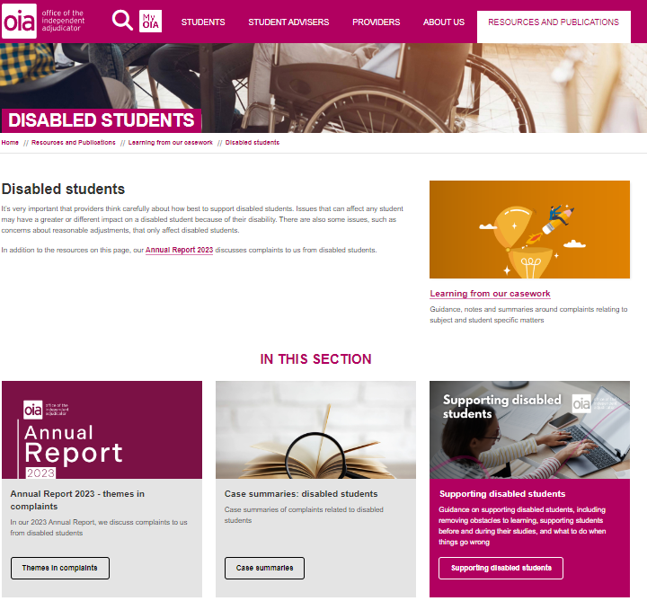
OIA resources
Supporting disabled students - OIAHE
Case summaries about disabled students
Notes:
If you aren’t familiar with our work, we have issued guidance specifically about disabled students and complaints processes, and we also publish case summaries which can help inform your practice.

Slide 10
Contact us

