Slide 1
The Disabled Student Commitment & EHRC note of learning
NADP Workshop
Prof Deborah Johnston
21 January 2025
Notes:
Background to the Commitment
How it helps
How to sign up

Slide 2
EHRC note of learning
EHRC Note of Learning, published July 2024
Focus of today’s session: hear more about aim of Note from EHRC, the response from OIA and the approach taken in two Higher Education Providers.
Set the scene and talk about the way that the Disabled Student Commitment can provide a supportive environment. Two broad areas of focus in the Note:
  knowledge of disability; and competence standards

Slide 3
Disabled Student Commitment
Requests to share information
On-course experience
Moving forward
Choosing a course of study
Transition into higher education
Five chapters that contain 43 principles across the student lifecycle.
15 for sector bodies, who commit to reporting regularly on their progress.
29 for HEPs to map with their disabled students. Publishing an annual action plan.
Disabled Student Commitment | Advance HE (advance-he.ac.uk)
Notes:
Principle 13 is shared!
Core planning group: partnership between Advance HE, Deborah Johnston (London South Bank University) and NADP to take forward all planning and implementation activities
Advisory Group: containing members directly mentioned in the Commitment, or carrying out relevant work in the sector
Partnership Group: a wider group of interested sector members, carrying out relevant work
Student Advisory Group: a group of 15 current disabled students, informing the work of the Advisory and Partnership groups
The core planning group, with input from AG, PG and SG, submitted evidence to various consultations (such as OfS funding, UUK White Paper). Speak at conferences.
Alignment with OfS’ Disability in Higher Education Advisory Panel

Slide 4
Progress:
Sector
Department for Education
Office for Students
Department for Work and Pensions
Student Loans Company
UCAS
Disabled Students’ UK
QAA
Advance HE
Disability Access Ambassadors
Institute of Directors
Business Disability Forum

Slide 5
Progress:
HEPs
Birmingham City University
Brunel University London
Edinburgh Napier University
London South Bank University
New College Durham
Nottingham Trent University
Open University
Solent University
The University of Law
University of Central Lancashire
University College Birmingham
University of Exeter
University of Greenwich
University of Hertfordshire
University of Liverpool

Slide 6
Why get involved?
How does signing up to the Commitment respond to EHRC Note of Learning
The Commitment as a sign of institutional attention and senior buy-in
Using the mapping documents to focus action.
Various special interest groups (SIGs):
  Transition to HE
  Transition to employment
  Sharing information
  Student and staff disability frameworks in HE
  Student advocacy and knowledge of rights
  Technology in education
  Inclusive practice, including alternative assessment methods and Universal Design for Learning
  Competence standards and the anticipatory duty

Slide 7
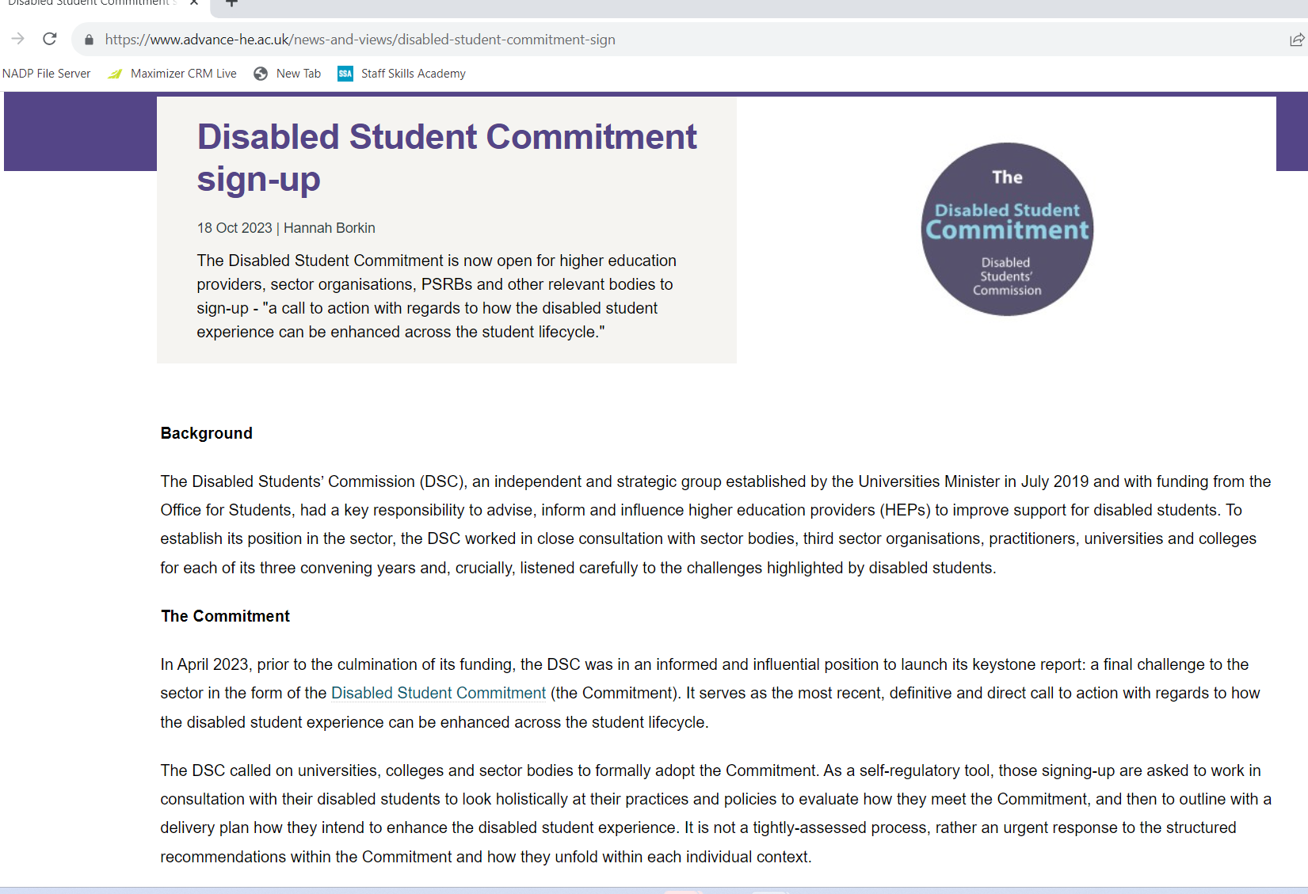
How to sign up?
Register your interest form, or email
dsc@advance-he.ac.uk
An email/letter signed by Vice Chancellor or equivalent
Named key contact
Statement of current position

Slide 8
Thank you for listening.
Please do contact me with any questions or queries
Deborah Johnston johnstd3@lsbu.ac.uk

