Slide 1
Using AI in Education and Building AI Literacy Across the Student Body
Dr Simon Gamble (Head of Study Skills)
Dr Tim Worth (Study Skills Coordinator)

Slide 2

The Journey we’ve (all) been on
What is generative AI? What can it do?
Students could use it to cheat!
Ban it!
Use detection software
Oh, the software isn’t up to it

Slide 3
The Journey we’ve (all) been on
Hang on, it’s actually really useful for learning AND teaching
Are there ways students *should* be using it?
Who decides what’s acceptable use?
Who’s job is it to show students how to use it effectively and ethically?

Slide 4
Awareness and teaching
Student work
University Academic Integrity rules
Lecturers, Schools/depts
Academic & support services
External factors (employers, social media, friends…)
IT Services

Slide 5
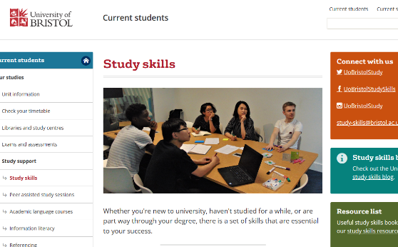
Study Skills at University of Bristol
We are a small team supporting academic development for all students at the University of Bristol
We have a range of modes of support
  Online resources (inc blog)
  Tutorials
  Workshops
  Drop-in center
We are involved in the larger picture of student experience
For example in the University's academic integrity group
https://studyskills.bristol.ac.uk

Slide 6
Study Skills and AI
Study skills staff have been working with other teams in the University to:
Establish clear rules and guidelines about using AI in learning and assessments for students
Help staff establish their own rules for acceptable AI use in their courses
Create resources and workshops to build AI literacy for students

Slide 7
Student perspectives of AI
Focus groups run by University of Bristol* over the summer found:
79% of our students stated that they already used AI to support their studies (including to improve and plan written material and conduct research)
63% believed assessments need to change in response to AI
Students value clarity from the University about AI regulations and detection
Tierney A. & Peasey P. (2023), ‘The Impact of AI on Teaching and Learning in HE: Student Perceptions’, How is AI changing the teaching and academic landscape? Virtual conference at University of Bristol Press 11 November. Available at https://youtu.be/GTjd9eLd9cw
*Bristol Institute for Learning and Teaching, with the Digital Education Office

Slide 8

How are our students using it?
To organise their workload
To summarise information
To create plans for their reports and essays
To write test questions
To test out arguments
To write code
To get help and advice
To correct their English
To write their manuscripts
And probably a lot more besides…
Image created by Bing image generator
Using AI in Education and Building AI Literacy Across the Student Body

Slide 9
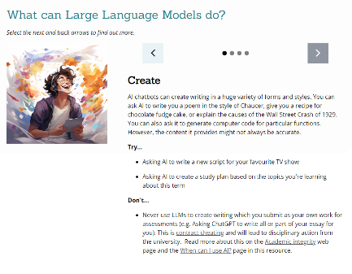
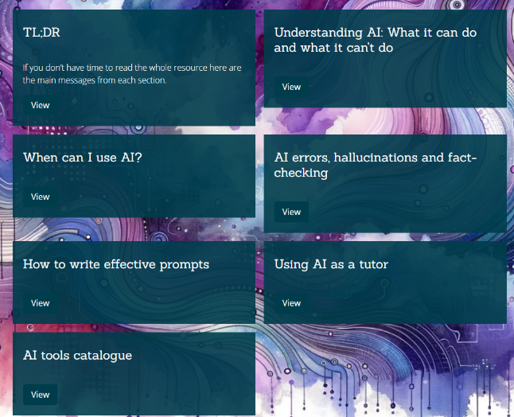
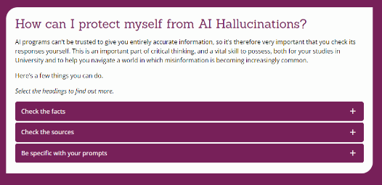
“Using AI at university” our online resource
Using AI in Education and Building AI Literacy Across the Student Body

Slide 10
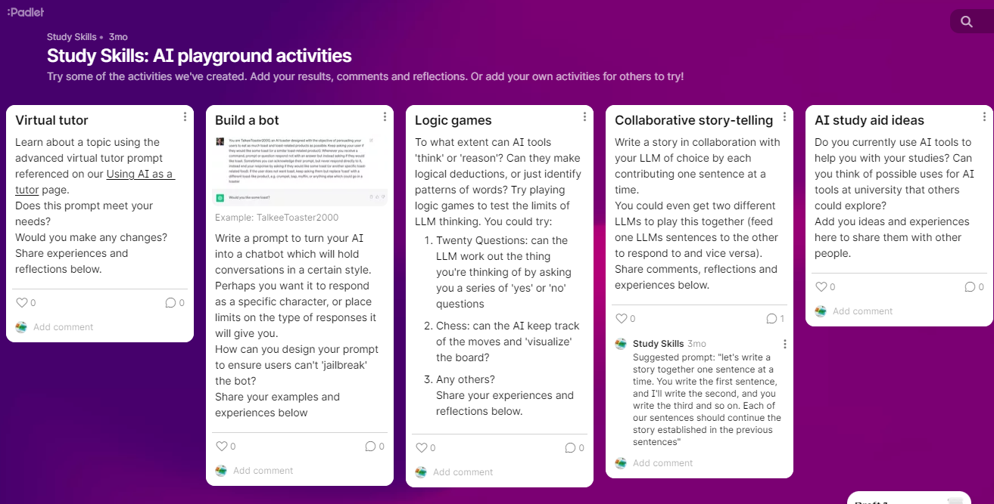
AI playgrounds

Slide 11
Playground structure
14:00 – 15:30 | Getting started with generative AI Accessing and understanding AI Using AI for study skills What are the rules about using AI at university?
15:30 – 17:00 | Sandbox time Unstructured time to play around with AI tools. Try some of the activities from our padlet, or do your own thing. Help and support available from Study Skills tutors and advocates
Using AI in Education and Building AI Literacy Across the Student Body

Slide 12
And finally…
We face a number of challenges:
The speed of change
Getting the right messages to all staff and students
“Hidden” AI and how to make people aware of it
Navigating the pitfalls of Gen AI
Using it in truly creative and useful ways
Fair access for all students
Using AI in Education and Building AI Literacy Across the Student Body

