Slide 1
AI and Accessibility: Inclusivity in Education
Shamima Akhtar - Policy and Research Manager
NADP Webinar - 24 January 2024

Slide 2
Overview
About Policy Connect
Findings: APPG for Assistive Technology report inquiry
Findings: Higher Education Commission report inquiry
Questions

Slide 3
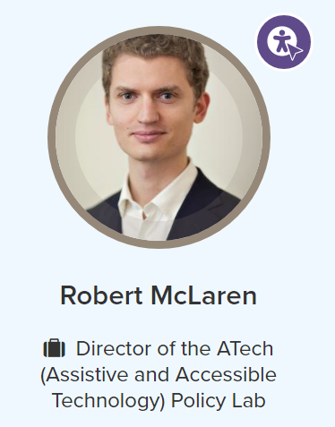
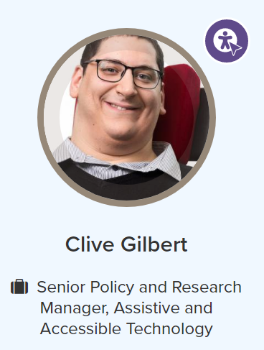
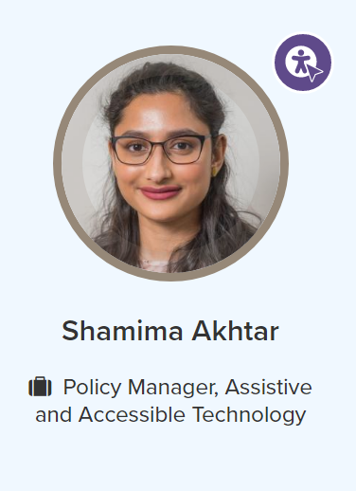
Who we are
Cross-party think tank
Assistive and Accessible Technology
Industry, Technology & Innovation
Sustainability
Health
Education & Skills
All Party Parliamentary Group for Assistive Technology
ATech Policy Lab
National Centre for Accessible Transport

Slide 4
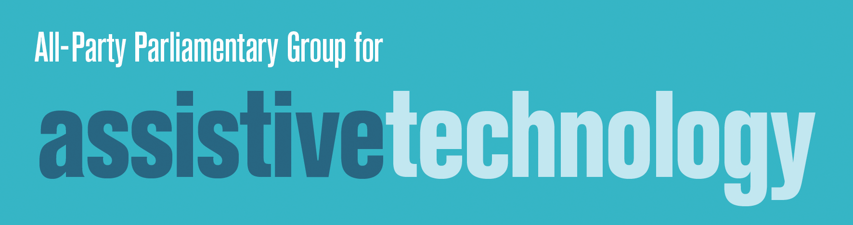

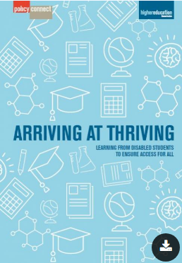
        Our Research
Key finding:
  Disabled students leaving education without knowledge of benefits of AI and AT
Key recommendation:
Support disabled students' successful transition to employment

Slide 5

        Why?
How technology is used in supported employment by disabled people in:
  Supported Internships
  Apprenticeships
  Supported employment roles
Notes:
Key Findings:
Disabled students leaving education without knowledge of Access to Work
Employees and employers have poor understanding of digital barriers and benefits in the workplace
Access to Work doesn’t put AT in place fast enough for short term placements

Slide 6

Interim Findings
Awareness of AT
How do we know about AT?
Access to AT
How to get access to AT?
Notes:
Chicken and egg pic.

Slide 7
Core Themes
Improving access to AT
Workforce training opportunities
Employer awareness of AT

Slide 8
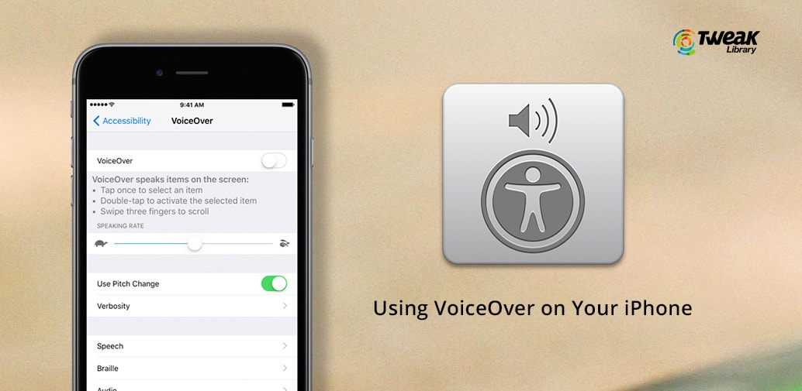
Supporting literacy
Porter – Supported Internship
“we have young people having to advocate for themselves in job interviews because people don't understand the accessibility features on a mobile phone that are built in whether you have Android or Apple […] we've gone into a local hospital recently and shown them how to use the accessibility features on an iPhone to allow all of their porters to use text-to-speech. Because actually a huge amount of their Porters had low levels of literacy, not simply the young man we have.”

Slide 9
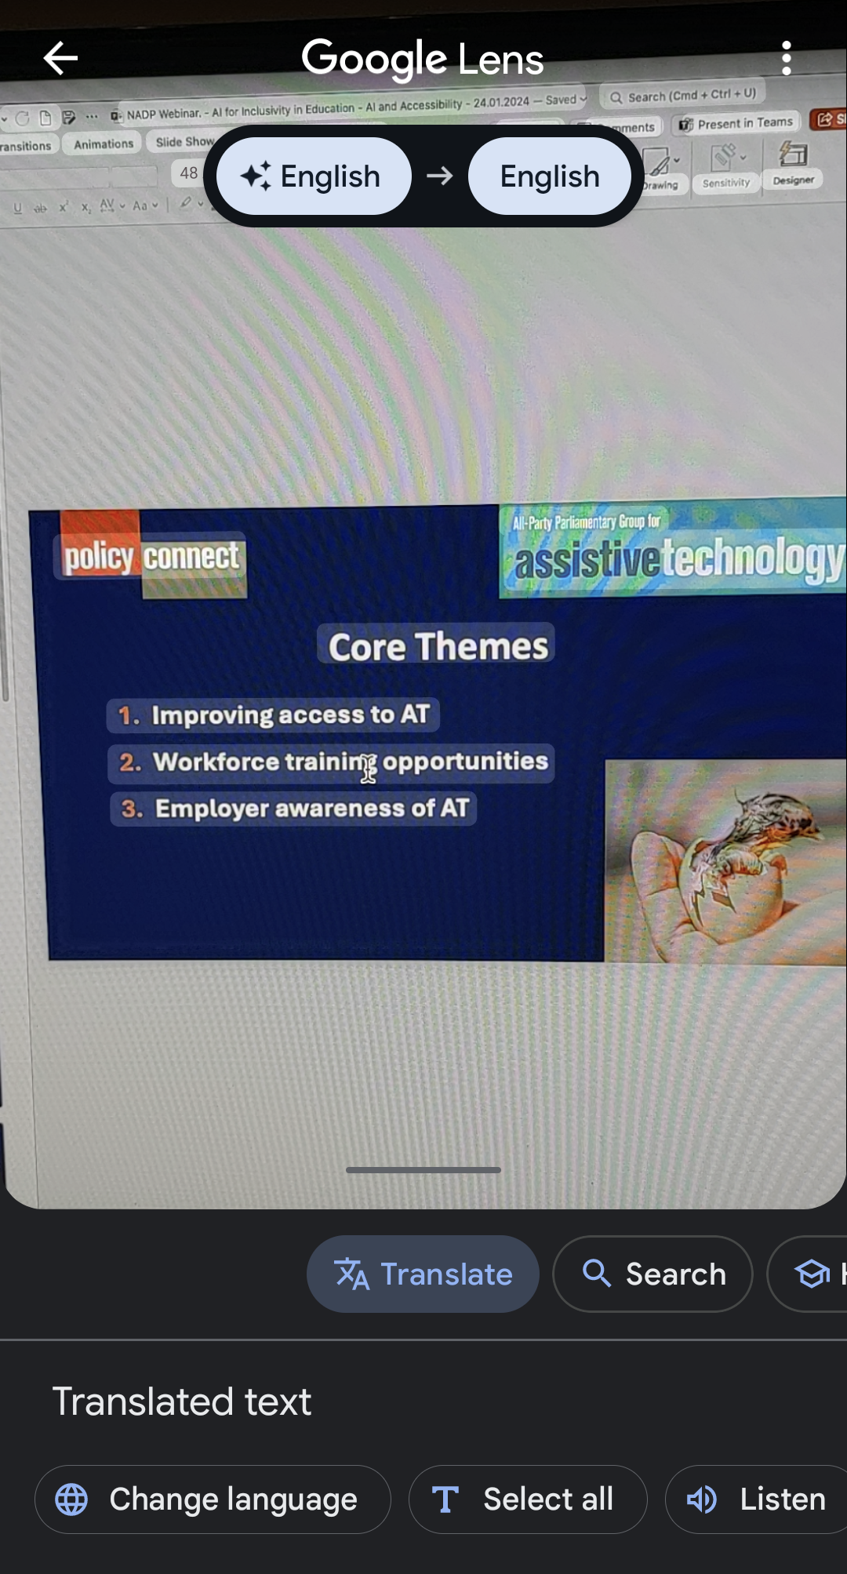
AI and literacy
Google lens as a text-to-speech tool
Google lens as a translation tool

Slide 10

AI in recruitment
IPS Employment Specialist
“I often feel that what we're trying to do in supported employment is teach people the rules to a game which no one's explained to them. […] And something that we've recently tried doing is the use of ChatGPT. […] AI, for example in writing CVs, particularly application forms. So it's very easy to generate for free a resume or a covering letter for example, for someone that is applying for an engineering post and nursing post. And obviously the intention is that you tailor that to the individual.”

Slide 11
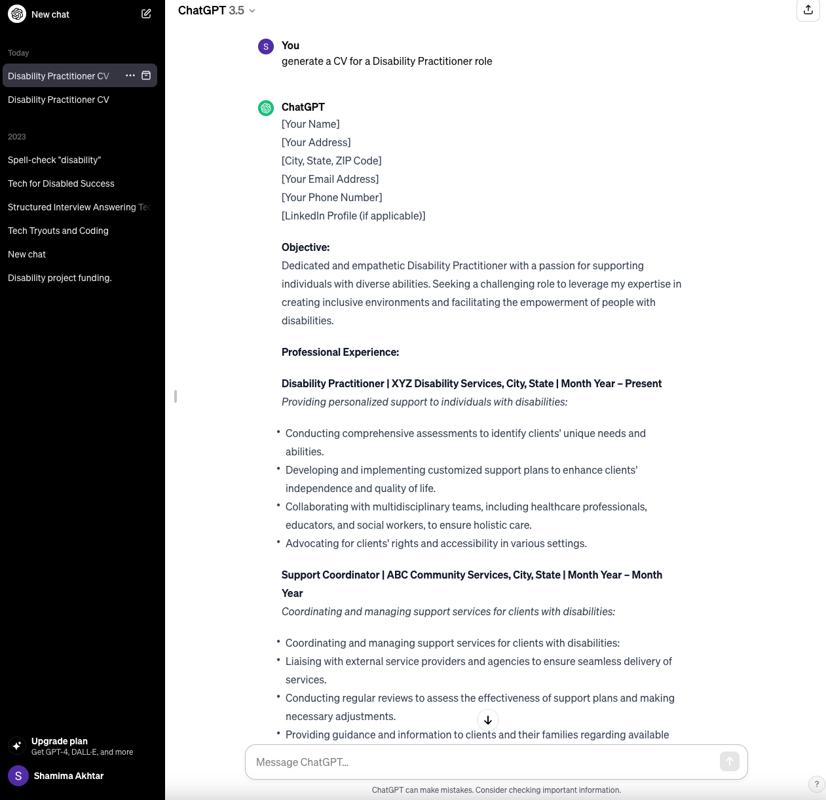
Chat GPT
– CV skills

Slide 12
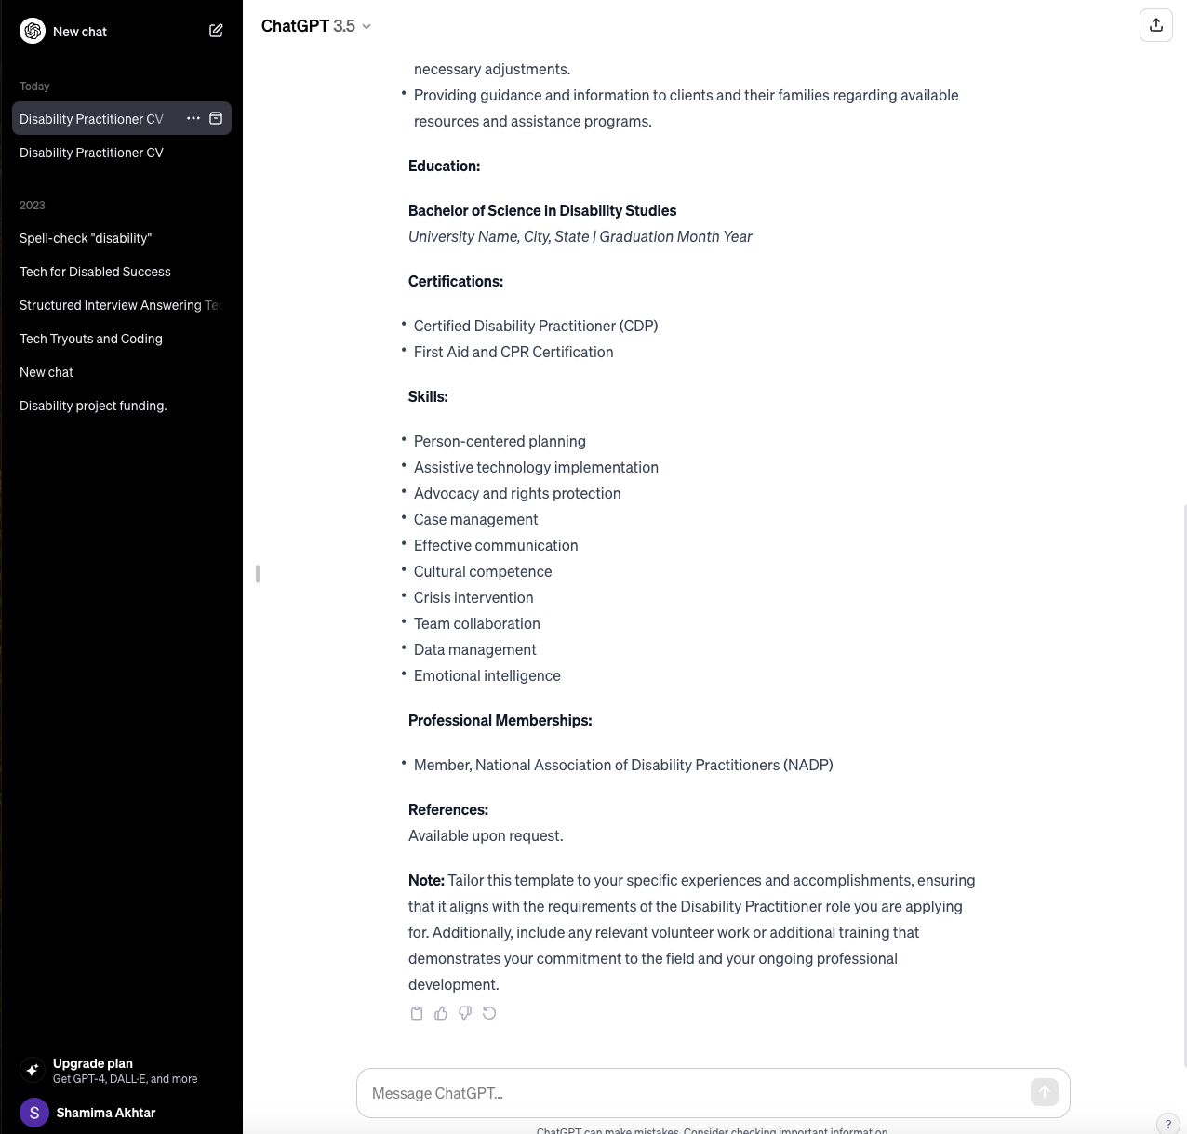
Chat GPT
– CV skills

Slide 13
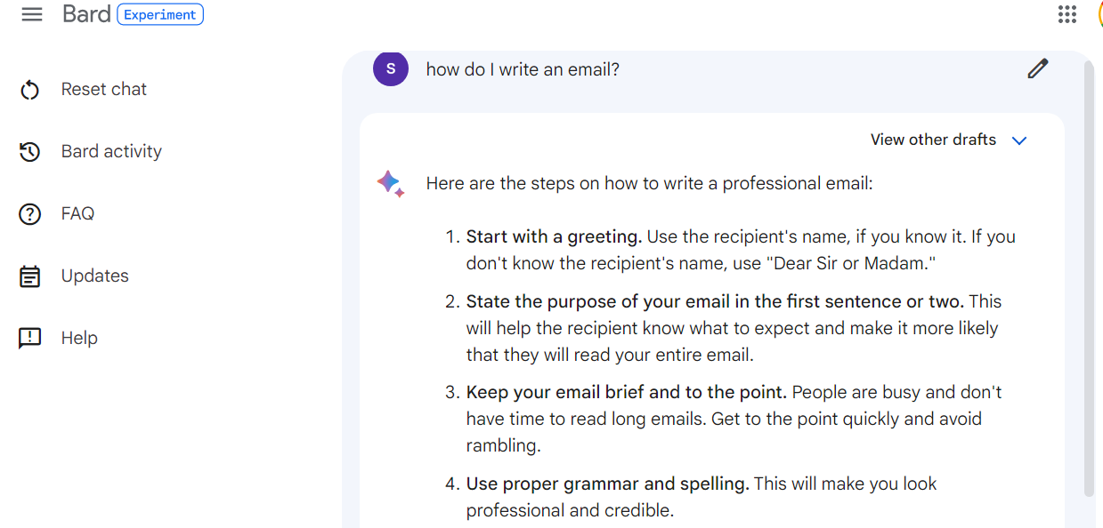
Google Bard

Slide 14
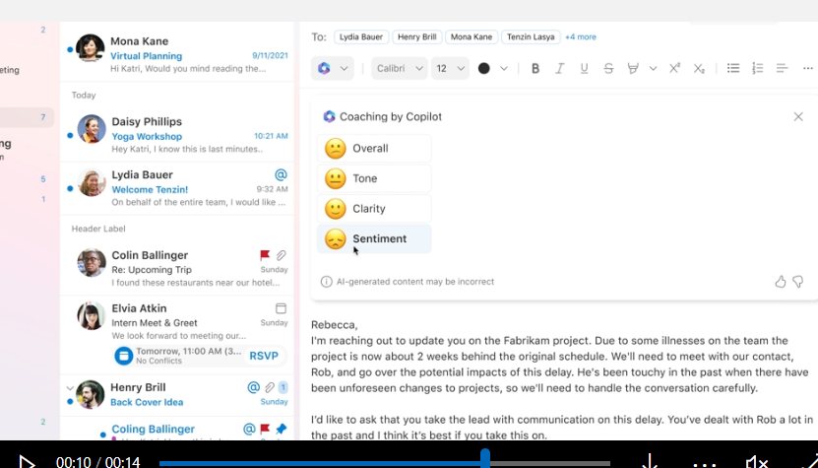
Microsoft 365 Copilot

Slide 15

Findings: Blended Learning
Cost – Gen AI paywalls
Procurement of tech
Co-production of AI with disabled people

Slide 16
Getting involved
          Twitter/X:
              @AT_APPG
              @ATechPolicyLab
              @ShamimaAkhtar
        LinkedIn Newsletter - ATech Policy Lab
        Email: Shamima.akhtar@policyconnect.org.uk
Email: Alyson.Hwang@policyconnect.org.uk

