Slide 1
The Potential of Generative AI for Disabled Students

Slide 2
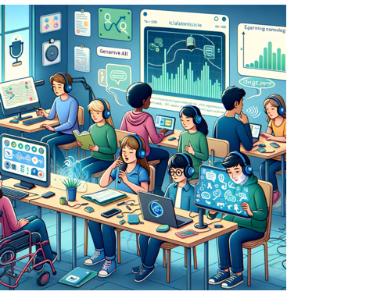
The potential of generative AI for the inclusion of students with diverse abilities
It can potentially enhance accessibility through text-to-speech and speech-to-text features, aiding visually and hearing-impaired students.
AI's adaptability can support personalized learning, crucial for those with specific educational needs.
It can aid in communication for students with speech disorders and increase engagement for those with ADHD or autism as an interactive tool.
AI can also assist in cognitive tasks and physical accessibility, potentially benefiting students with cognitive and physical impairments.
Additionally, can provide emotional support, is available round-the-clock, and can help in monitoring and improving learning outcomes based on data analysis. Importantly,
AI use in education can minimizes stigma and offer a private learning environment.

Slide 3
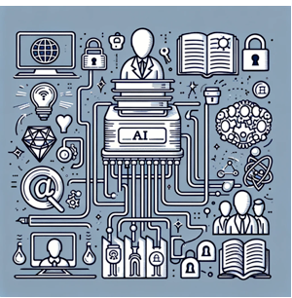
Ethical considerations
There are ethical considerations, for example,
data privacy,
issues of copyright
and the level of human oversight in AI powered applications and automated decision-making systems.
The nature of the technology does not make it easy to understand the legality of the processing of personal data and copyrighted material, the laws on which are in reference to print and replication technologies rather than the large language model deep learning processes of generative AI.

Slide 4
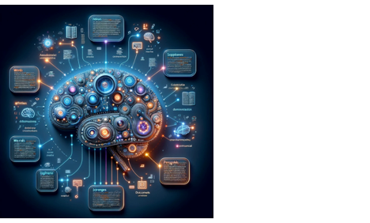
What is generative AI?
Generative AI works through the identification of patterns in text (or images and multimedia). To explain the significance of this and how it works, I will focus on text but the same principles apply to images and multimedia.
The image created visualizes the concept of generative AI, like GPT-4, processing text. It depicts a digital brain with different sections that light up, each representing a level of text analysis, from words to paragraphs and documents. The brain is surrounded by floating texts at various layers, showing connections that symbolize relationships between these elements. This representation captures the multi-layered and complex process of text analysis by an AI system.

Slide 5
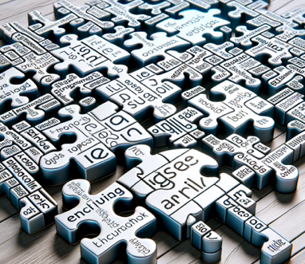
How generative AI works
During its training (GPT-4 involves around 300 billion words from publicly available text on the internet in multiple languages) layers or neural networks identify distinct entities iteratively but always in relationship to other entities.
The easiest way to understand this is at the word level, although the same process is taking place at sentence, paragraph, document and discourse level. The identification of a word symbol has a relationship to other words.
The model in the large language model thus has a probabilistic relationship between words that is dependent on context.
THE GENERATED IMAGE FEATURES A PARTIALLY COMPLETED JIGSAW PUZZLE WITH PUZZLE PIECES REPRESENTING VARIOUS WORDS. THIS ILLUSTRATES THE NEURAL NETWORK'S LEARNING PROCESS, WHERE IT IDENTIFIES AND ASSOCIATES WORDS IN CONTEXT, LIKE HOW PIECES OF A PUZZLE ARE CONNECTED TO FORM A COMPLETE PICTURE.

Slide 6

What this means in practice
This means that when a prompt is introduced, the generative AI is looking for the most plausible response based on the probabilistic relationship between words as well as other features of the text. What this means is that generative AI is a powerful translator it can take a text prompt and transform the text in a way defined by the prompt instruction to another form while retaining the meaning of the original.

Slide 7
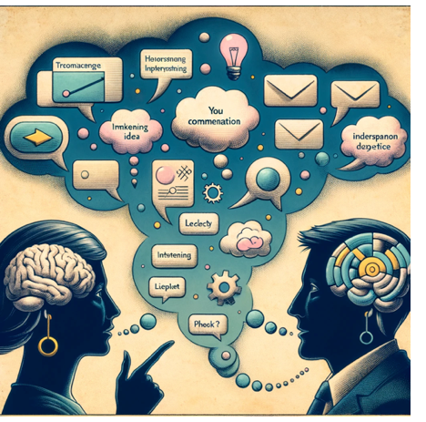
The universal translator
This underlies the potential of the technology, not as an information or knowledge tool, but one that works on meaning.
For instance, the capacity to take an interpretative role underpins the potential for inclusion for disabled students.
One of the central ideas is that it assists in taking a set of individualised thoughts and meanings and help the student consider and reflect on the meaning of their ideas from the perspective of other audiences.
This is the universal translator principle that also allows some roughly drafted ideas to be developed into a form suitable for assessment.

Slide 8

The integration challenge
The big challenge lies in developing the capacity in educational contexts to take advantage of the potential benefits of the technology. Much guidance is highly generic and does not always fully comprehend the technology, which is not a criticism of individuals and groups, but a reality of this technology. We can explain its technical architecture and imagine what its capabilities are but until we use the technology in educational contexts, it is not easy to understand the technology and what it might do. Neither can we develop guidance.

Slide 9
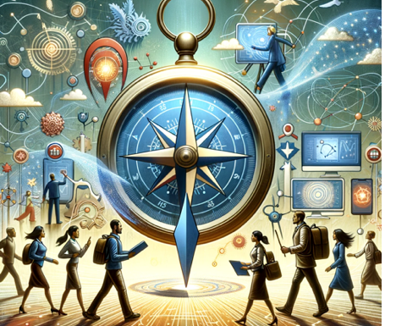
Effective integration and learning with generative AI
This underscores the importance of practitioners in inclusion, accessibility, and disability sectors having access to resources and opportunities to work with students using new technologies like ChatGPT. It emphasizes starting with basic applications, such as employing ChatGPT to explore various methods of developing and articulating ideas. This approach facilitates a gradual understanding of the technology's potential in enhancing communication and learning for students with disabilities. The focus on starting simply is crucial, allowing practitioners and students alike to acclimate to the technology and discover innovative ways to use it in educational and communicative contexts. This can lead to more effective and personalized learning experiences for students with disabilities, aligning with their unique needs and abilities.

Slide 10
A practical examples of how generative AI, like ChatGPT, might be used in the field of inclusion, accessibility, and disability
Text Simplification and Summarization: The student is assigned a complex text that is challenging to comprehend due to their dyslexia. Using ChatGPT, the text is inputted, and the AI is asked to simplify and summarize the content. This process makes the information more accessible and manageable for the student.
Writing and Composition Assistance: When the student needs to write an essay or a report based on the text, they can start by dictating their ideas to ChatGPT. The AI can help organize these thoughts into a coherent structure, suggest improvements, and even help with grammar and spelling, which are often challenging for those with dyslexia.
Interactive Learning and Clarification: The student can then interact with ChatGPT to ask questions about the text. For example, they might ask for definitions of difficult words, or to have certain concepts explained in simpler terms. ChatGPT responds in real-time, providing immediate clarification and aiding in the student’s understanding.
Feedback and Iterative Learning: As the student progresses, they can use ChatGPT to get feedback on their work. The AI can point out areas that need improvement or suggest alternative ways to express ideas. This feedback loop allows for iterative learning, where the student gradually improves their understanding and communication skills.

Slide 11
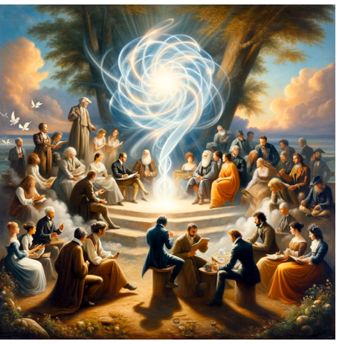
Effective integration of generative AI into educational settings necessitates collaboration between practitioners, learners, researchers, technologists, and education policymakers.

