Slide 1


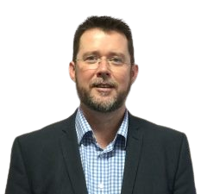

With you today
Adam Hyland
Director of Accessibility and Inclusion for Diversity & Ability and NADP Advisor
Artificial Intelligence for Inclusive Education
Webinar: 24th January 2023
John Harding
Head of the Disability Resource Centre (DRC) at the University of Cambridge and NADP Advisor

Slide 2
Introduction and Scene-setting
Is Artificial Intelligence (AI) new?
Should we be worried about AI?
Are we already using AI for inclusion?

Slide 3
It’s all around us!
What I am using:
Text-to-speech
Alexa
Smart glasses
Global autocorrect
Apple Watch
Grammarly
What Education is using:
Plagiarism detection
Transcription of lectures
Academic research
Chatbots
Facilities management

Slide 4

https://nadp-uk.org/
Thank you!

