Slide 1
Disabled Students: The Importance of Being Seen and Heard
Serena Christie
STAART Ambassador

Slide 2
Overview:
Who am I?
What is STAART?
What are the STAART Principles of Disability – SPoD?
Mottos of various models of disability

Slide 3
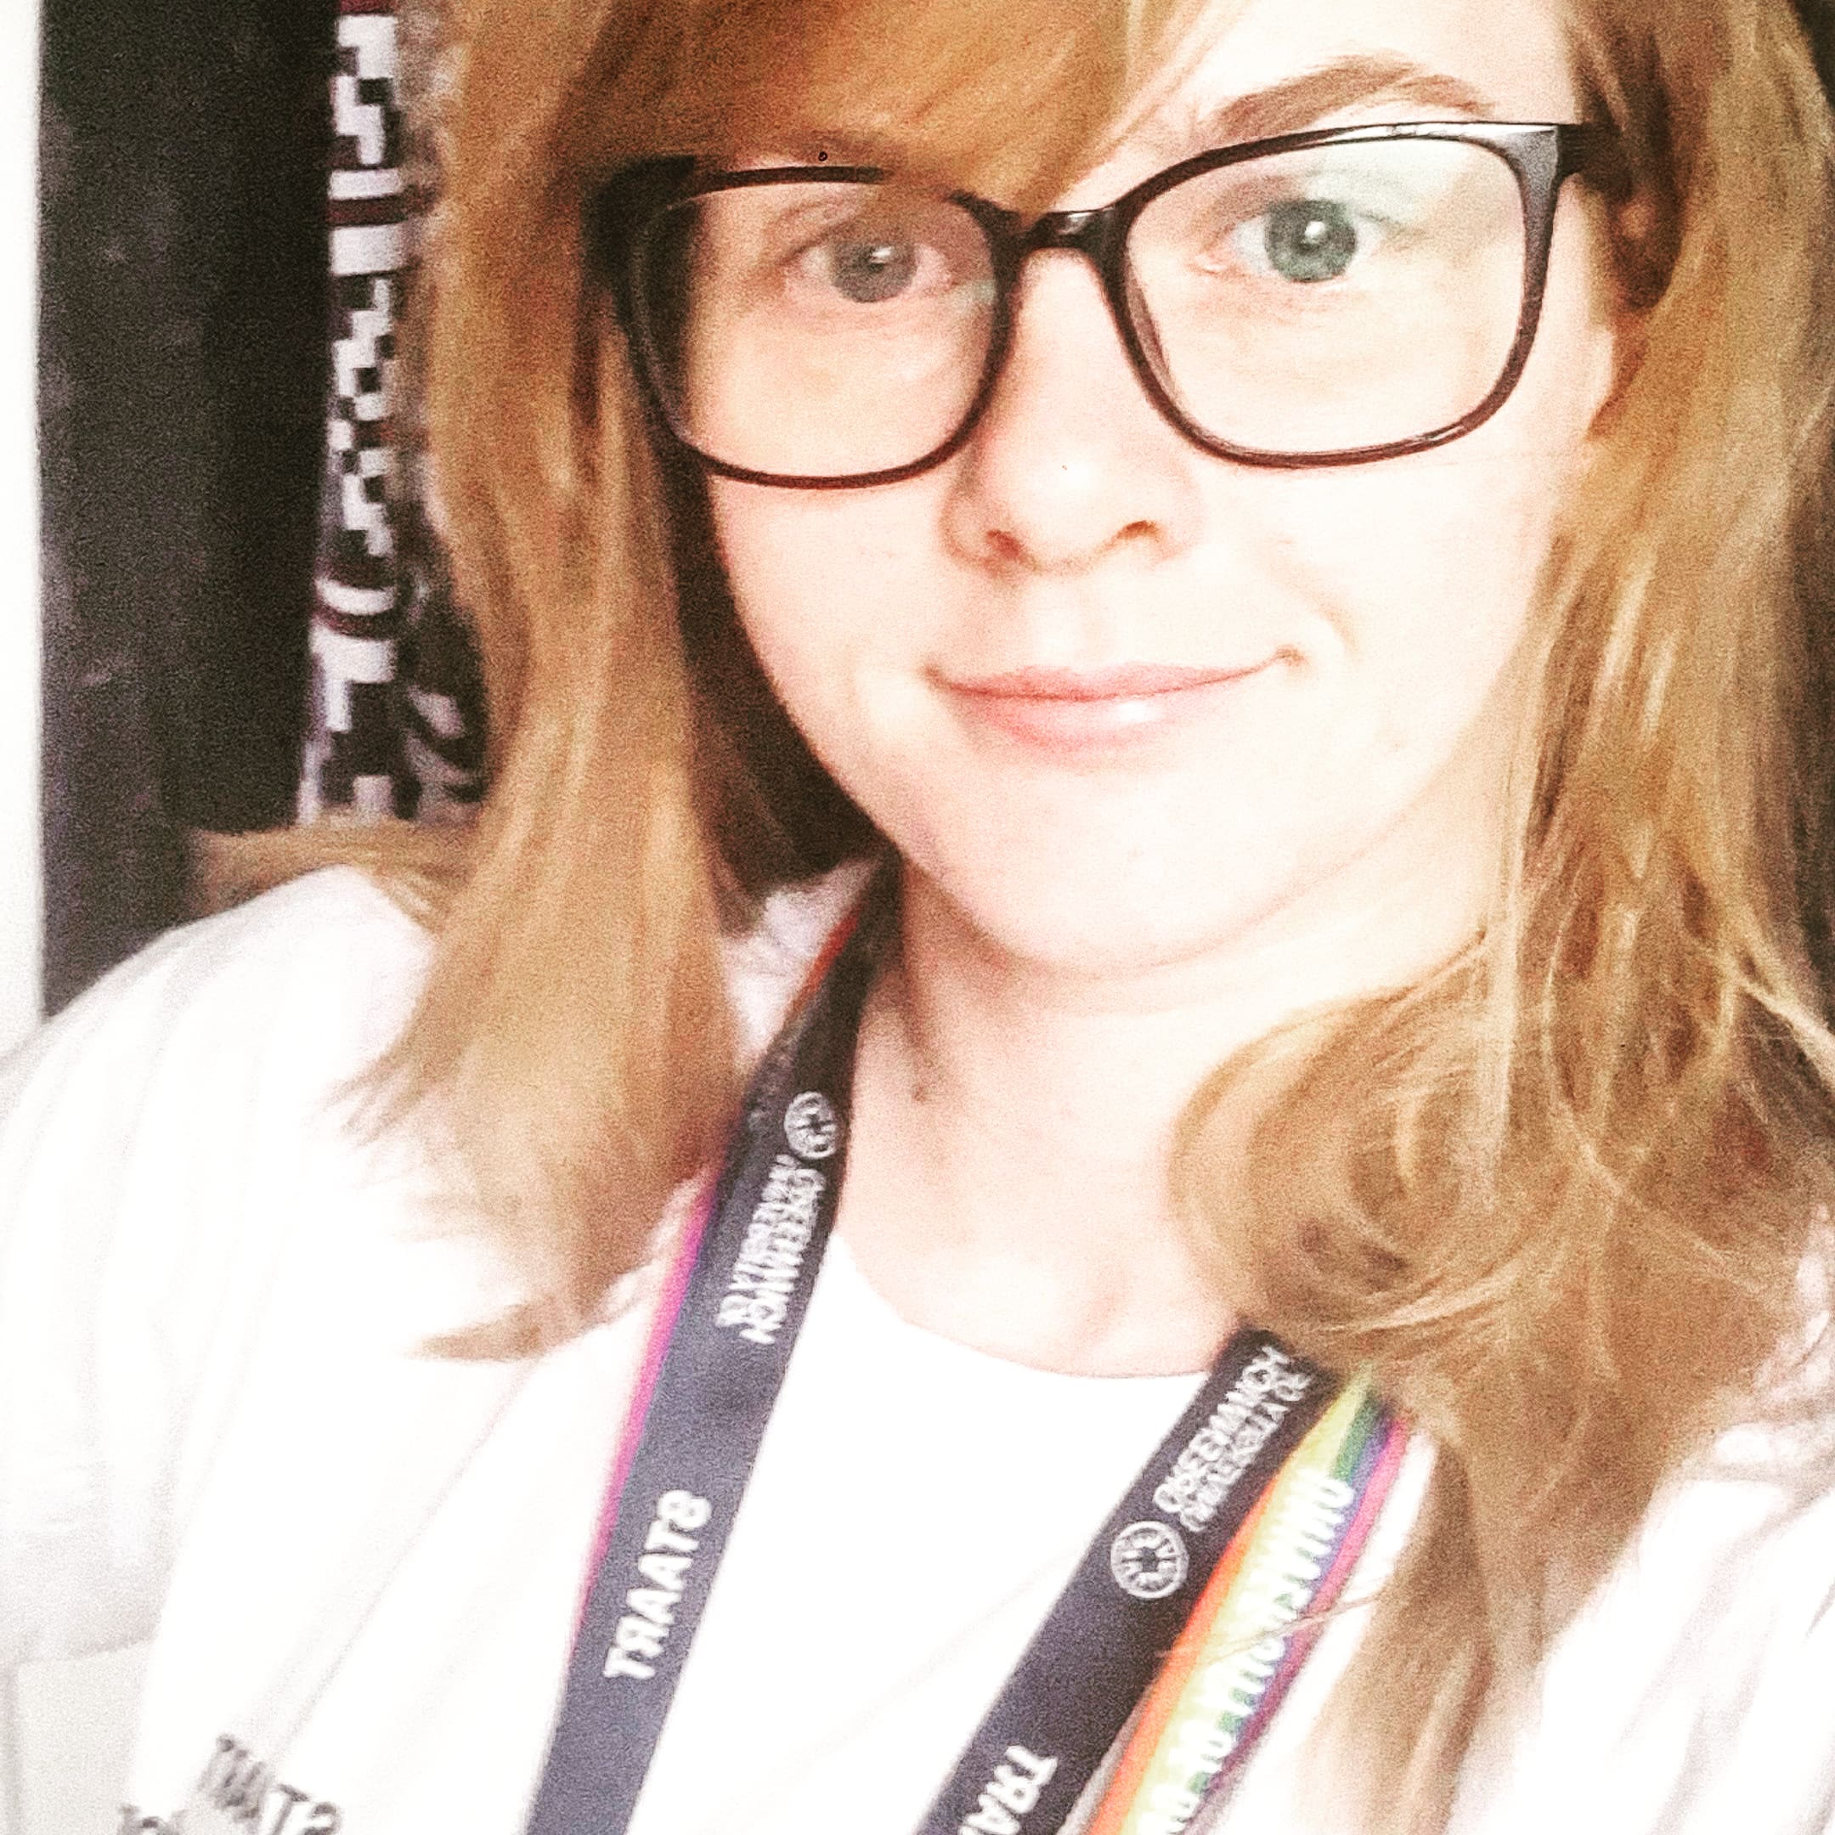
Who am I?
Serena Christie
Keynote speaker in Mental health and Substance use disorders
STAART Ambassador, Student Peer Mentor
2nd BSc Paramedic Science Student
ADHD and previous history of mental health disorders
I became a STAART Ambassador to represent my community and help students thrive

Slide 4
What is STAART?
We provide impartial IAG for disabled folk considering university.
STAART Ambassadors & Graduates (*SAs & *SGs) are self-selected, self-identifying disabled University of Greenwich students who are paid by the university to undertake a variety of roles.
*SAs & *SGs are identified by their STAART t-shirts and lanyards.
In the past two years, *SAs & *SGs have been paid as consultants to work with UCAS, DSA, SFE and the Disabled Students’ Commission.

Slide 5
STAART Disability Pride Month Exhibition
STAART partnered with the University of Greenwich Disabled Staff Community (DSC) and the National Association of Disabled Staff Networks (NADSN) to create an astonishing and incredible exhibition - The Great and the Good, the Bad and The Ugly - to acknowledge Disability Pride Month (DPM) and Disability History Month.

Slide 6
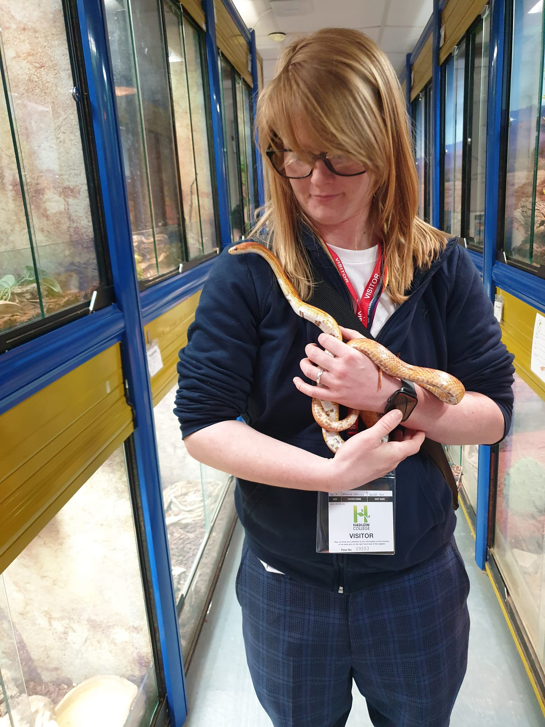
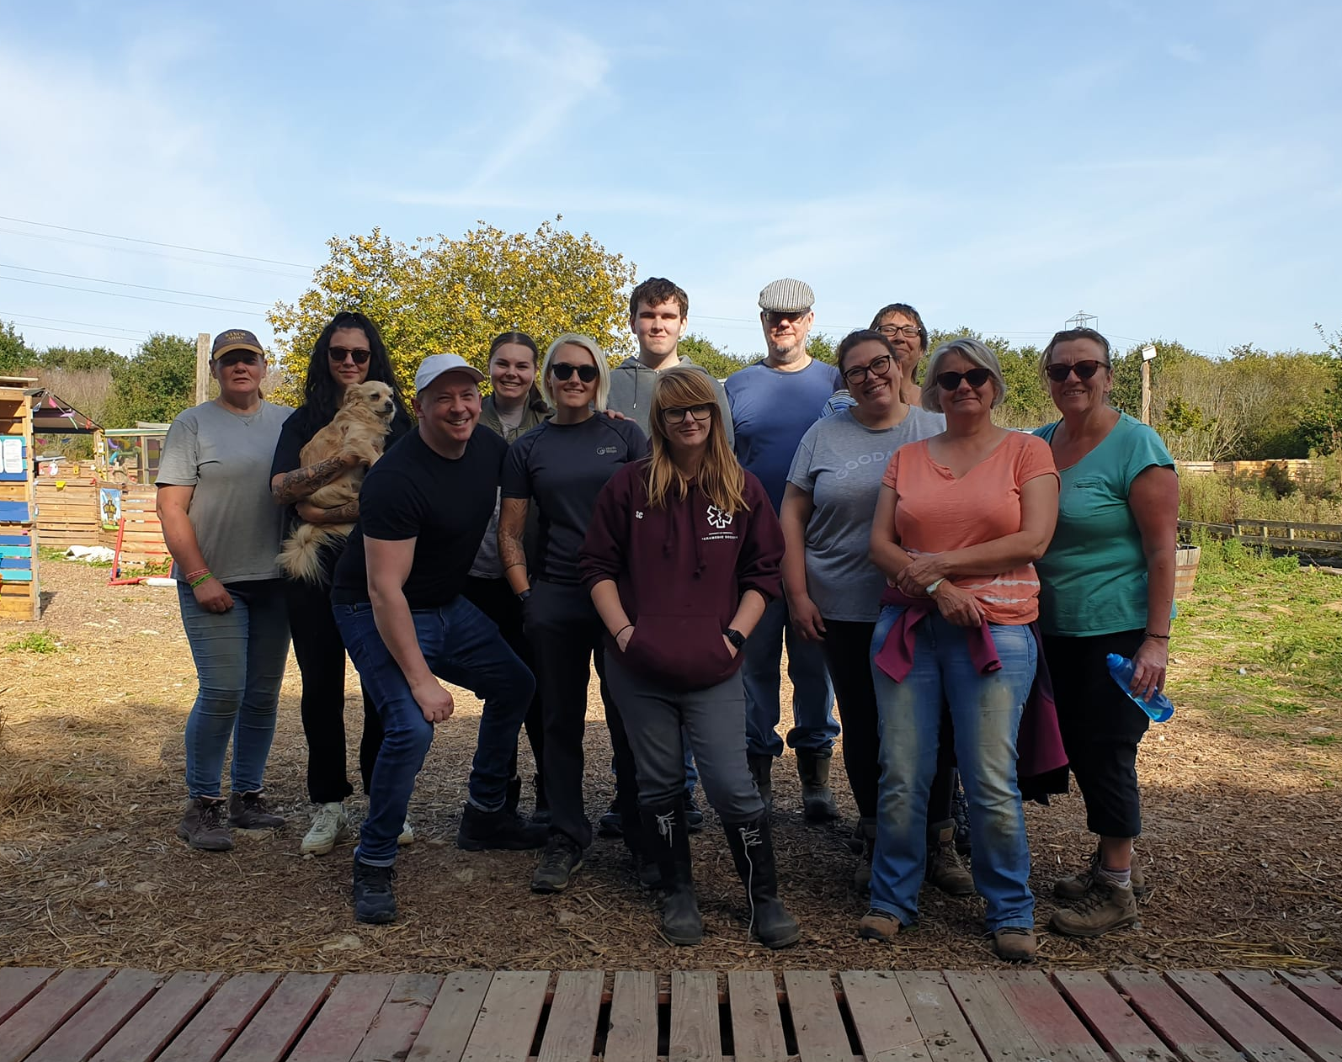
STAART Community Projects

Slide 7
What are the STAART Principles of Disability (SPoD)?
The SPoD is a lighter version of an updated model of disability building on social and affirmative models of disability.
The SPoD was created by over 220 self-selected, self-identifying UoG disabled students; disabled staff and disabled alumni.
The SPoD was adopted across the university in December 2023.
A Creative Commons licence is being attached to the SPoD to enable other organisations to adopt the principles for their own institutions.
Notes:
Melanie was taught by Professor Mike Oliver which is why we acknowledge how fundamentally the social model of disability is/was for many disabled folk.
The Creative Commons licence will also enable other universities to have their own STAART Ambassadors.

Slide 8
Mottos of various models of disability
Medical model – fix people.
Social model – nothing about us without us.
Affirmative model – loud, proud and angry
SPoD – we are experts by experience.

Slide 9
Thank you for listening
Any questions or comments?
STAART | Support | University of Greenwich staart@gre.ac.uk
Notes:
You can also post anonymous questions and comments during the Q&A session at the end of the day

