Slide 1
Creating a Student Panel in Higher Education
The Disability Services’ Student Panel at the University of Leeds
Lucy Elliott – Operations Team Manager, Disability Services
Megan Owen – Engagement Officer, Disability Services
Suchita Pandit – 5th Year Medical Student

Slide 2
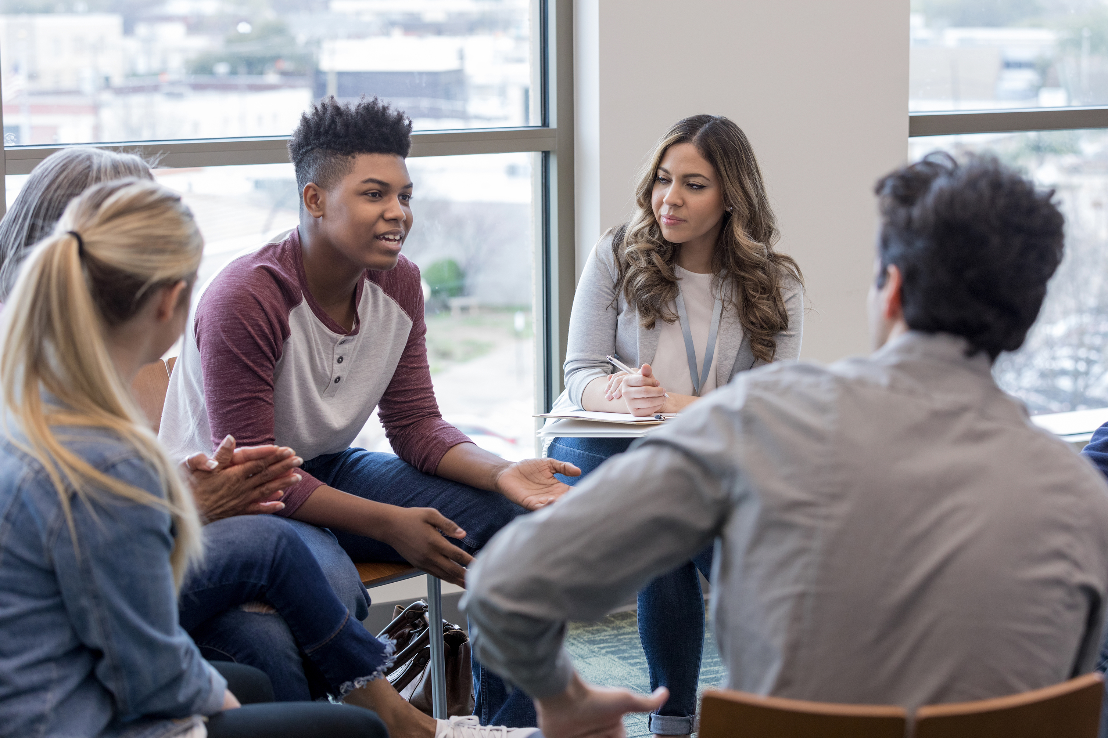
History and Purpose of the Student Panel
Started in 2018 and has run annually since.
Purpose:
To recognise the importance of the student experience.
To enable disabled students to influence Disability Services.
To give disabled students the opportunity to learn more about the Service.
To collate views and feedback about other aspects of University provisions.

Slide 3

Recent Topics
Communication with disabled applicants and current students
Experience of exams at Leeds (and previous study)
Accessible accommodation – joined by Leeds City Council
Disability Contacts based in the Schools across the UoL
Assistive Technology at the UoL
Inclusive teaching at the UoL
Disabled Students’ Allowances – from application to support provided by our in-house NMH supplier.

Slide 4
Recruiting a Panel
Email campaigns
Social media
Highlight “rewards”
Highlight “what’s expected”
  A willingness to engage in discussions, share ideas and give feedback.
  A commitment to attend as many Panel meetings as possible throughout the year.
Application form
Selection
Why you should apply:
Have your say!
Build a community
Feedback across campus
Skill Development
Get behind the scenes
CV Building.

Slide 5
Lessons from the Panel
In-person first meeting: works well for breaking the ice
Keep talking and don’t be afraid to make changes: ongoing feedback is essential
Consider the level of formality
Small group discussions – student voice, not our voice
Shorter meetings – 1 hour (initially 2 hrs).
Scheduled dates – advertised + chosen on a Wednesday afternoon when there is less teaching.
Outcomes – not as important as you think!

Slide 6
Suchita’s perspective - Reason for joining
Meeting like-minded individuals.
Sharing experiences in a validating space.
Connecting with people from different courses and years.
Building confidence and enhancing the CV in a 'safe' environment.
Contributing and giving back to disability services.
  Addressing the lack of specific disability training for school disability contacts.
  Discussed exam format improvements.

Slide 7
Good things about the panel
Gaining insights from diverse courses and years.
Learning about unknown support options.
Combating the feeling of isolation among neurodivergent individuals.
Providing support to others through shared experiences.
Monthly meetings that easily fit into schedules without feeling demanding.
Having a voice in shaping disability services.
Understanding the efforts of staff running disability services.
Meeting and discussing disability-related issues with city council members.

Slide 8

Suggestions from members to improve the panel
Scheduling meetings "after hours" to avoid clashes with timetabled classes.
Considering longer meetings with external speakers for in-depth discussions.
Providing more notice for specific questions from external speakers.
Exploring more outreach to include other disabled students.

Slide 9

Learning & reflection points
Feeling a sense of belonging within the panel and sharing similar experiences.
Strong community sense since the first meeting, overcoming initial nervousness.
Validation of experiences aiding focus on work and recognizing shared struggles.
Recognition of how Disability Services are trying to improve disabled students’ experiences.

