Slide 1
A 'Towards Inclusivity' model for reasonable adjustments in Higher Education.
Louise Grimmett and Ben Watson, University College London (UCL)
Notes:
Our aim: Our session will be a space for practitioners to discuss their own challenges in this field and provide the space and time to reflect on how they can best steer change within their respective HEIs.

Slide 2
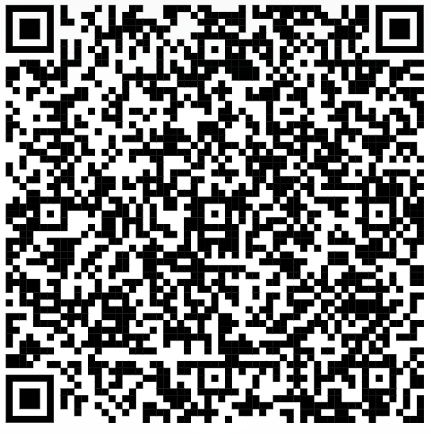
Towards Inclusivity paper link
Towards Inclusivity paper
  https://tinyurl.com/Towards-Inclusivity

Slide 3

An introduction to us and the 'Towards Inclusivity' model.
Introducing Louise...
Introducing Ben...
Introducing the model...
Why 'towards inclusivity?'
Notes:
Louise to state her description and context
Ben to state his description and context
Ben to introduce the model, bring in Kent background.
The ‘towards inclusivity’ document outlines simple but impactful adjustments to teaching and learning at UCL. The document was informed by a review of frequently requested reasonable adjustments at UCL, current research on inclusive practice within the Higher Education sector and an analysis of UCL's current teaching and learning strategies.
Why 'towards inclusivity', well we hope to be able to answer that towards the end.

Slide 4

An introduction to the 'Towards Inclusivity' model.
Outlines simple but impactful ‘towards inclusivity’ adjustments to teaching and learning at UCL.
The model has been informed by an analysis of frequently requested Summary of Reasonable Adjustments (SoRA) and current research on inclusive practice within the Higher Education sector.
Notes:
Why 'towards inclusivity'?

Slide 5
Additional considerations
Many Higher Education Institutions have helpful baseline principles for reasonable adjustments. Our aim was to create our own baseline principles whilst acknowledging that reasonable adjustments and environments need continual review. We believe that presently inclusivity is a fallacy, and we can only strive to move ‘towards inclusivity’ rather than something anyone can proclaim to have fostered.
Notes:
Nottingham Naps and Kent Kips
Ask audience for what they think is their most common reasonable adjustment
Inclusivity needs constant review and auditing.

Slide 6

Reasonable Adjustments: beyond our legal duty but within a threshold
Reasonable adjustments should be reasonable.
Who decides what's reasonable?
Reasonable adjustments should not positively discriminate against non-disabled students.
Reasonable adjustments equate to improved belonging and better outcomes for disabled students.
Notes:
Should be reasonable but from who's perspective?
Bullet point: the hardest example of this is a student who struggles with any form of deadline and wants to choose their own deadlines with no late penalties. Another example would be a disabled student who wants to use a shared space but requires to use this space as an individual workspace – an environmental change and one that would negatively impact how the space is used by other disabled students. Solutions for these examples? Could ask the audience.

Slide 7
What happens when we get it wrong?
Honestly, it kind of makes me question my future...like if they're not adapting any of the [learning materials] ...why even bother to put in the effort? It makes me lose confidence in learning and whether I'm going to be able to actually, get a job or go to uni or pursue what I want to do… I sometimes feel like I just get ignored". (3rd year Computer Science student with a visual impairment).
Notes:
Time-consuming
Administrative task
Increase in numbers of those with a reasonable adjustment plan (this is not unique to UCL).
Supports T&L depts with their anticipatory duty, a duty that is often forgotten.
Sets a baseline standard.
Supports the idea that an adjustment that can benefit a disabled student, will ultimately benefit all students. Adjustments at an individual level are seldom practical, particularly when working with UG and PG students. A research degree student will likely need an individualised plan.

Slide 8

Some key points from the model and data...
Supportive for both students and academic departments
Academic year: 19/20: 546 SoRAs created, 20/21: 961 SoRAs (43.1%), 21/22: 1534 SoRAs (59.6%), 22/23 (18th May) 3189 SoRAs (107.8%)
The invisible statistic: those uncategorised nor monitored
Notes:
Time-consuming
Administrative task
Increase in numbers of those with a reasonable adjustment plan (this is not unique to UCL).
Supports T&L depts with their anticipatory duty, a duty that is often forgotten.
Sets a baseline standard.
Supports the idea that an adjustment that can benefit a disabled student, will ultimately benefit all students. Adjustments at an individual level are seldom practical, particularly when working with UG and PG students. A research degree student will likely need an individualised plan.
Note the stats.
Third bullet point: carers, parents with an illness, students experiencing addiction or unwanted behaviours, those who are isolated and lonely.

Slide 9
Why does this matter?
Ethics - it’s the right thing to do.
Usability - the entire Higher Education community benefits.
  Competitive advantage.
    Discoverability of resources/impact.
      Teaching Excellence Framework (TEF).
      Research Excellence Framework (REF).
Legislation - we have to do it.

Slide 10
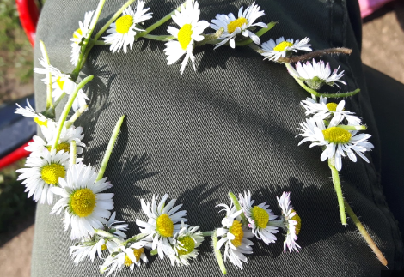
The building blocks of inclusivity...
'By building inclusive practices into an institution’s structure and operations, fewer reasonable adjustments will be needed over time. Where such adjustments are needed, the institution can be much more responsive to individual needs' (Office for Students, 2019).

Slide 11
If an adjustment works for everyone, is it still an adjustment?
We maintain that an adjustment for a disabled student can be beneficial for all students within the classroom, some of whom may not have a registered disability yet or may be experiencing a difficult time in their academic journey or personal lives.
Notes:
This leads us on to the ongoing debate around some adjustments only being made available to a disabled student, for example, the recording of a lecture. This goes back to our consideration of the invisible statistic – how many students require support or a simple adjustment that could support them to better engage with their studies in that moment of time.

Slide 12

Feedback from the UCL community
UCL have received the paper very well.
Active community of Accessibility Champions.
Academic schools keen to have practical guidelines.
Funding received to bring in the Disability Rights UK to support with reasonable adjustments and model.

Slide 13

Anticipated challenges
The size of UCL.
Embedding it within policy.
Fear of change.
Academic arrogance for practical application.
Performance rights over recordings / intellectual property.
Trade Union involvement.

Slide 14
Strategies, armour and tips
Kill them with kindness (first tactic).
Ask 'them' for an alternative.
Have they discussed this with the student (where appropriate).
Provide them with the worst-case scenario... "ok, if this doesn't happen, it may lead to a disability-discrimination complaint..."
Remind them of previous precedent.
Ask if they have checked their response with your University Legal team.
Notes:
Remind them that you are doing your job but you are on the same team – you understand it might be difficult but...
Put the onus back on them
It may not always be appropriate to bring the student into the conversation. It may be harmful and very stressful for them. They may have had a difficult experience with their department.
Alternatively, it can help to remind academics of the impact on the individual here. Humanising the experience rather than it being in black and white.
It can be helpful to remind decision-makers that saying no today is often their prerogative but it may lead to further difficulties later on. Reminding them of previous complaints, legal cases, health reports, audits, student-led reports led by the student union for example. Could give example of narcolepsy student here.
My team and I keep a tracker of all departments who have agreed to an alternative assessment and how easy or hard this was. Was there anything specific that worked to convince them here?
Get to know your legal team, they are employed to ensure the University meets their legal obligation and are more than happy to support us in being preventative.

Slide 15
Contact us
Louise Grimmett, Student Support and Wellbeing Manager (Disability and SpLDs), l.grimmett@ucl.ac.uk
Ben Watson, Head of Digital Accessibility, b-watson@ucl.ac.uk

